Slide 1
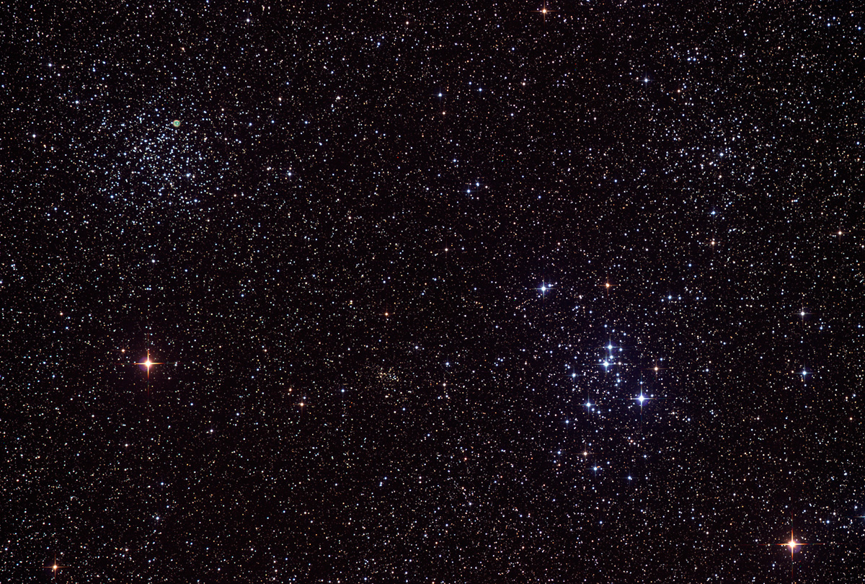

Howard
Astronomical
League
13
June 20, 2013

Slide 2
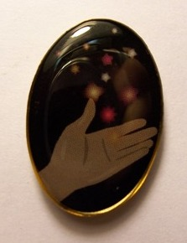
New Astronomical League award:
Chris Todd
Outreach Award #491
Basic (10 hours)
and
Stellar (Basic + 50 hours)
Notes:
And I’m half way to Master, which is Stellar + an additional 100 hours

Slide 3
HAL Librarian Wanted
Jim Nickel donated about 130 astronomy books to HAL in his will
We need someone with about 10 linear feet of bookshelf space to be the club librarian

Slide 4
Stumper Question

Slide 5
What have I got in my pocket?

Slide 6
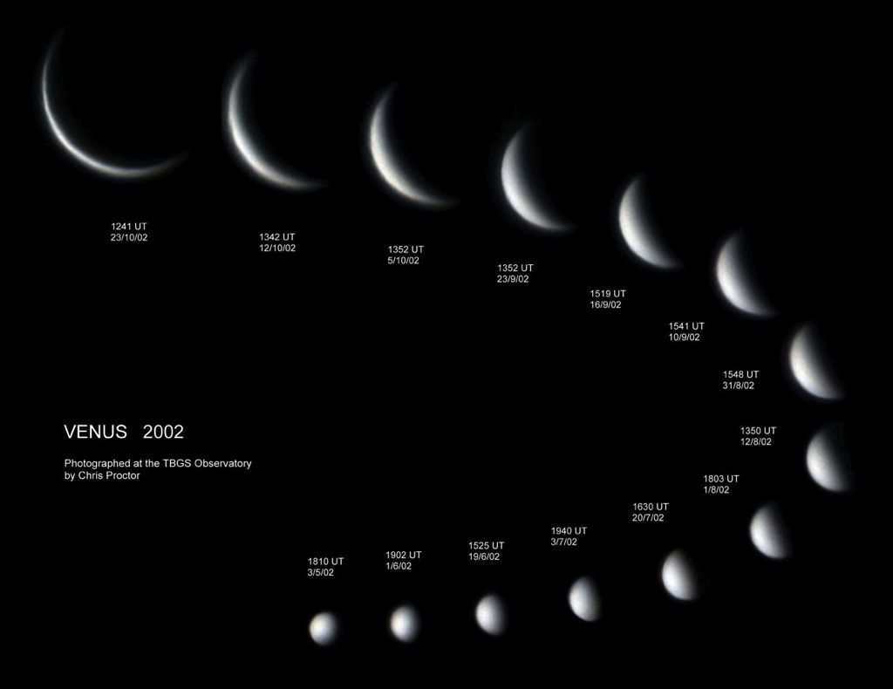
Notes:
Venus goes through phases, just like the moon, based on it’s geometric relationship between the Earth and Sun. As it moves through its phases, it also moves closer to, or further away from, the Earth, and so its apparent angular diameter changes. Image credit: http://linksthroughspace.blogspot.com/2012/02/venus-its-phases-transit-and.html

Slide 7
At what percentage illumination does Venus reach its greatest brightness (in 2013)?
Notes:
Clarification: as viewed from Earth.

Slide 8
Upcoming club activities

Slide 9
Star Parties!
July 6th – Members only Star Party
July 13th – Public Star Party (Celestial Searchers Star-B-Q before hand)

Slide 10
Member’s astrophotos and sketches

Slide 11
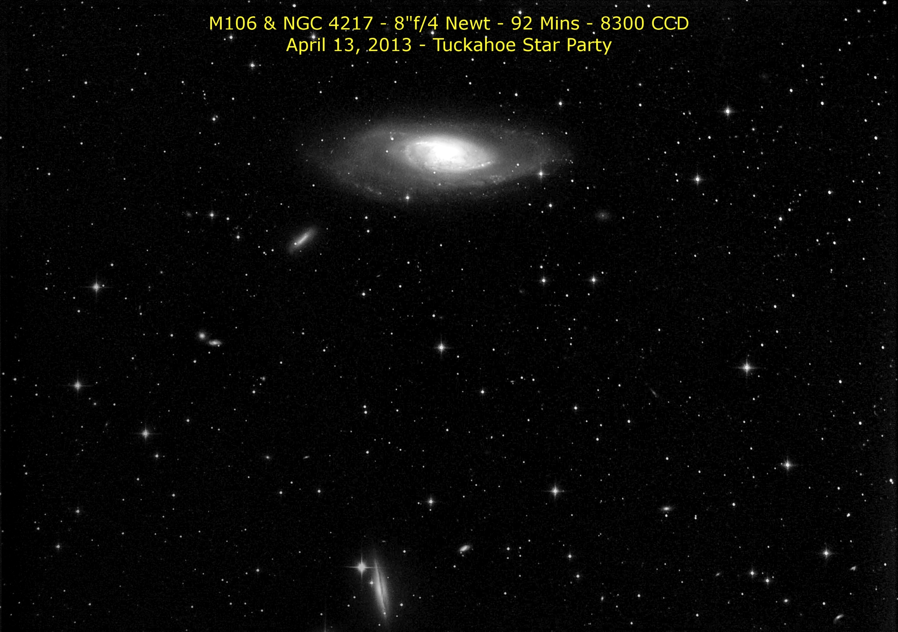
Gene Handler

Slide 12
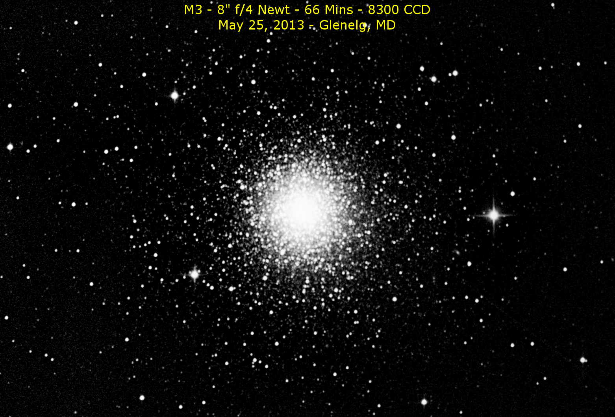
Gene Handler

Slide 13
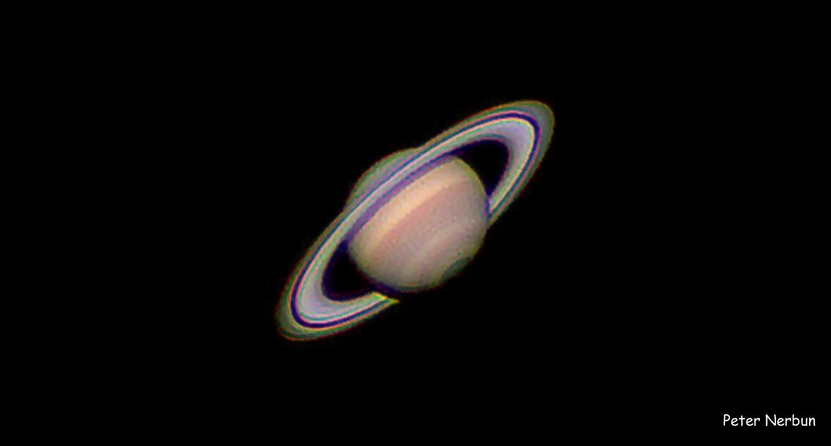
Peter Nerbun

Slide 14
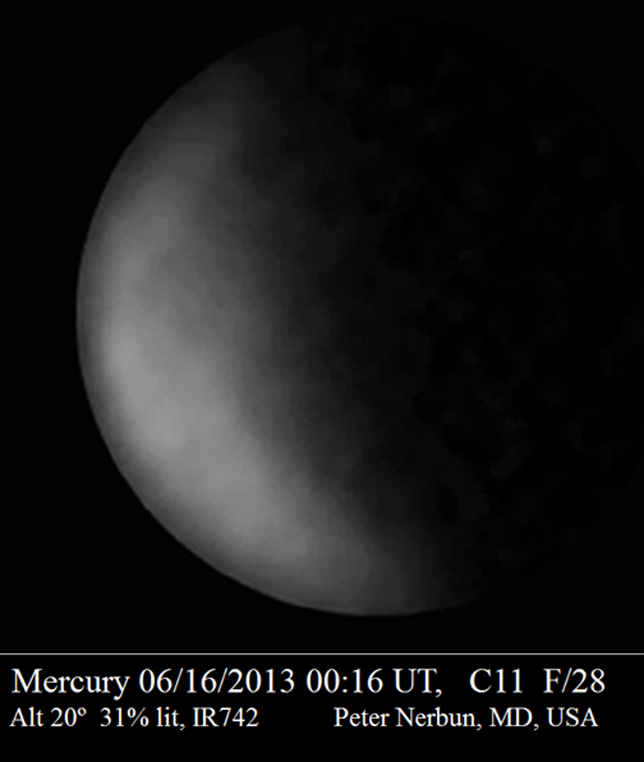
Peter Nerbun

Slide 15
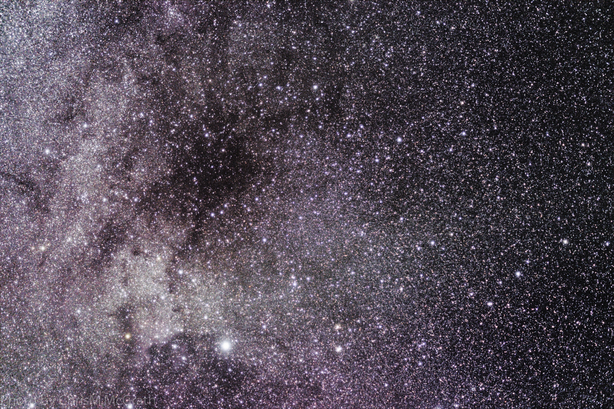
Chris McGrath

Slide 16
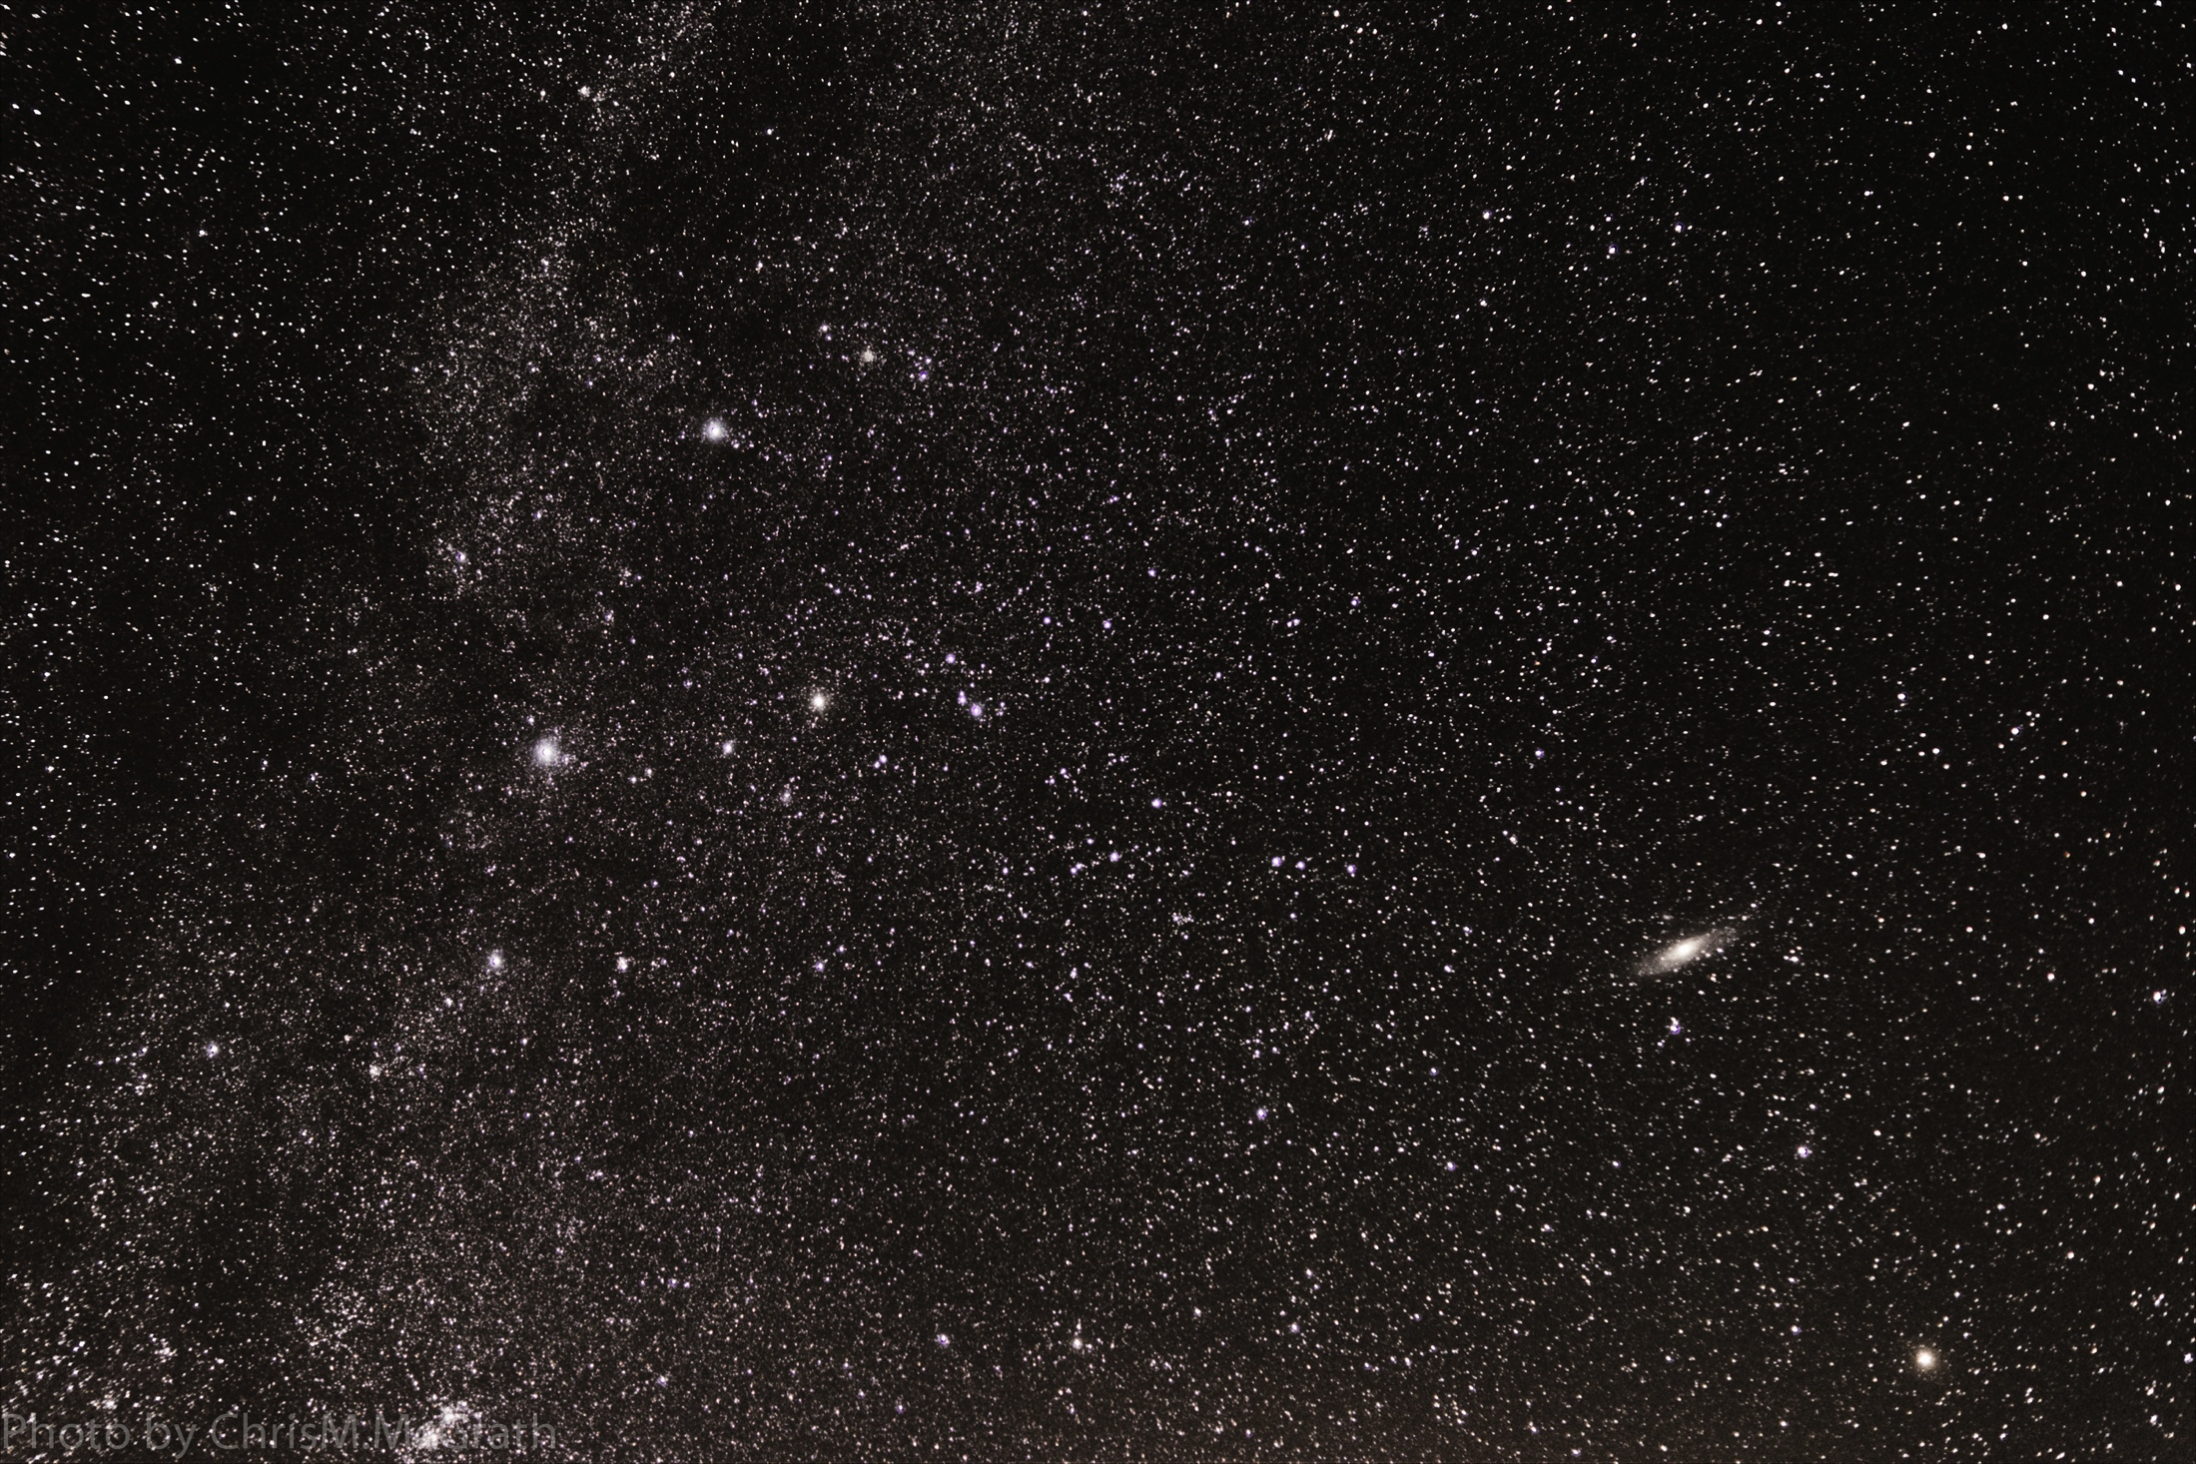
Chris McGrath

Slide 17
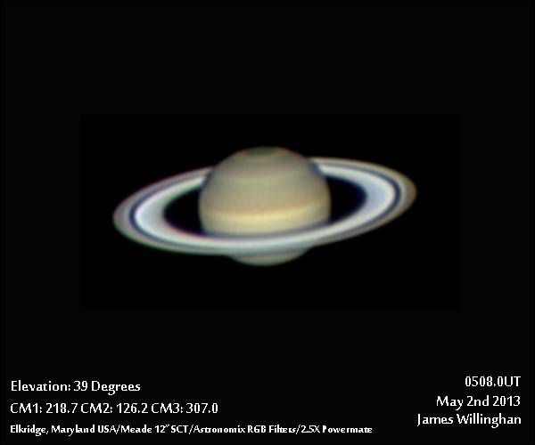
James Willinghan

Slide 18
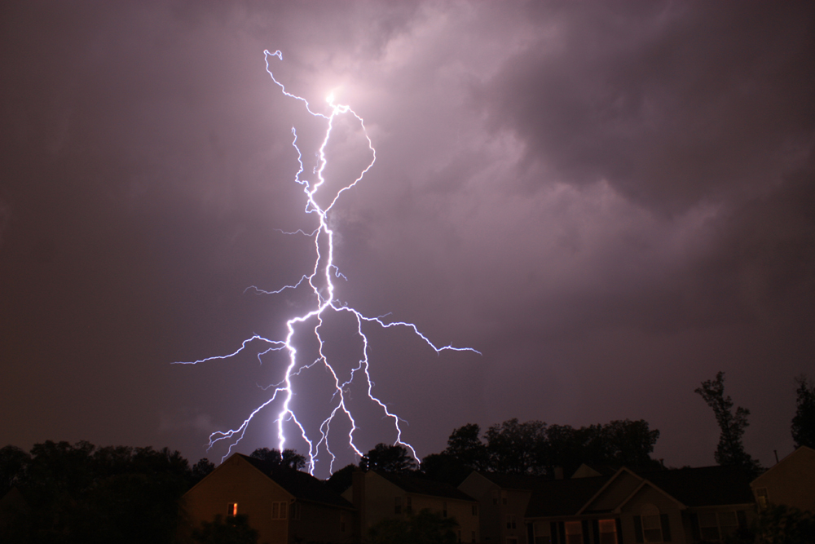
James Willinghan

Slide 19
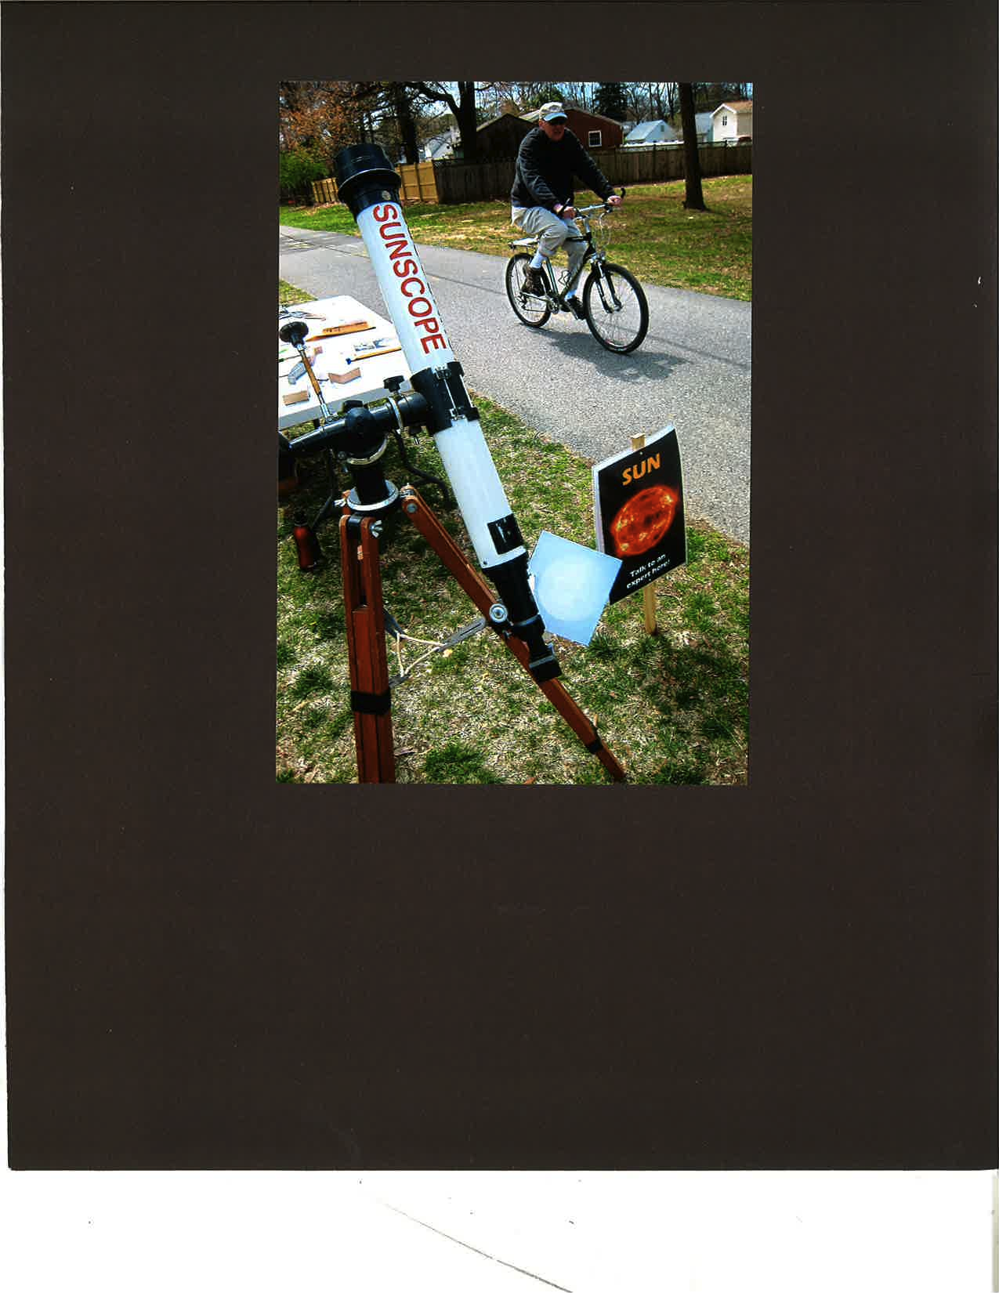
Herman Heyn

Slide 20
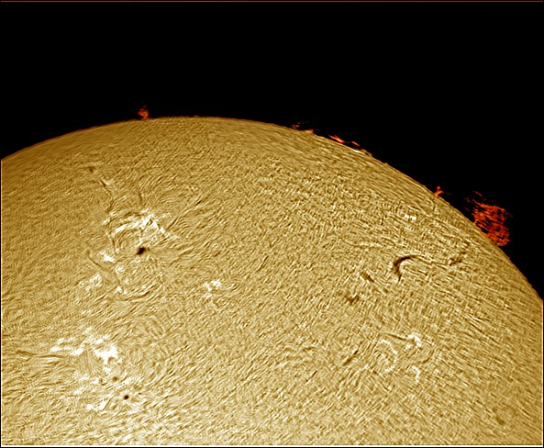
James Willinghan

Slide 21
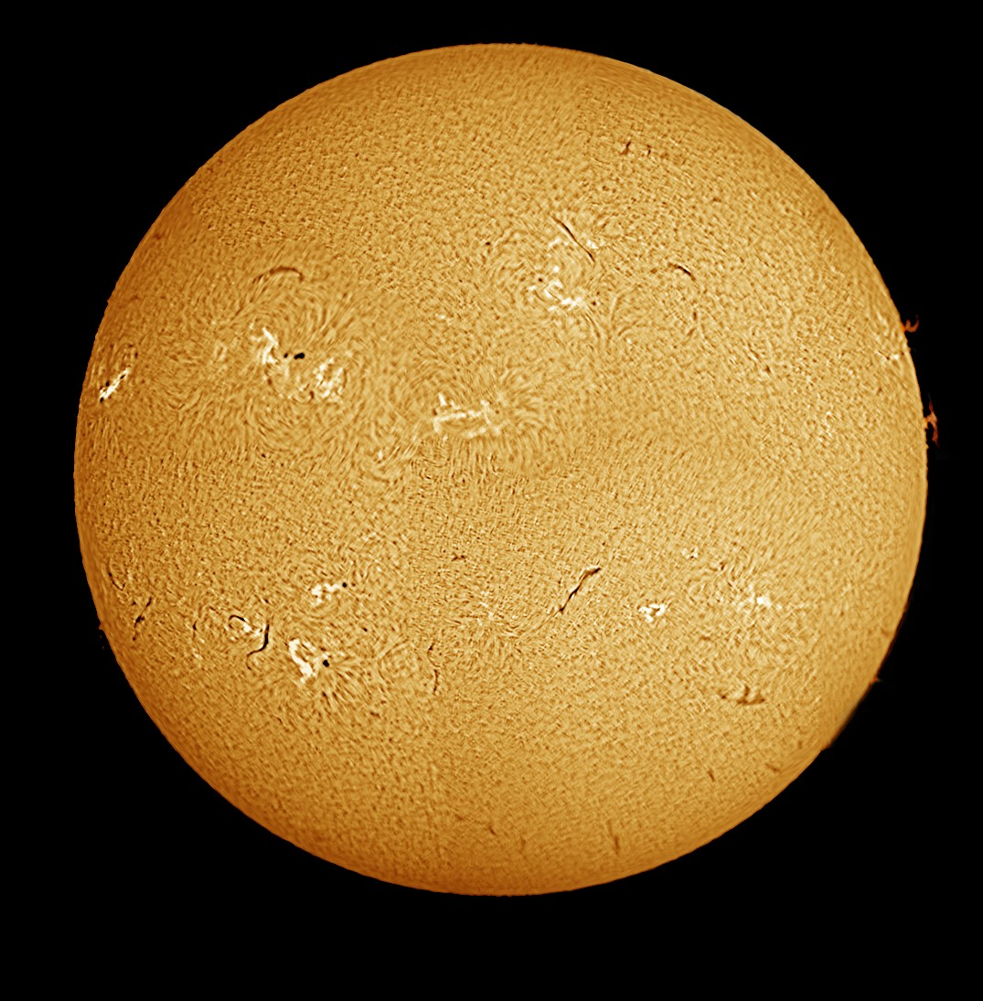
James Willinghan

Slide 22
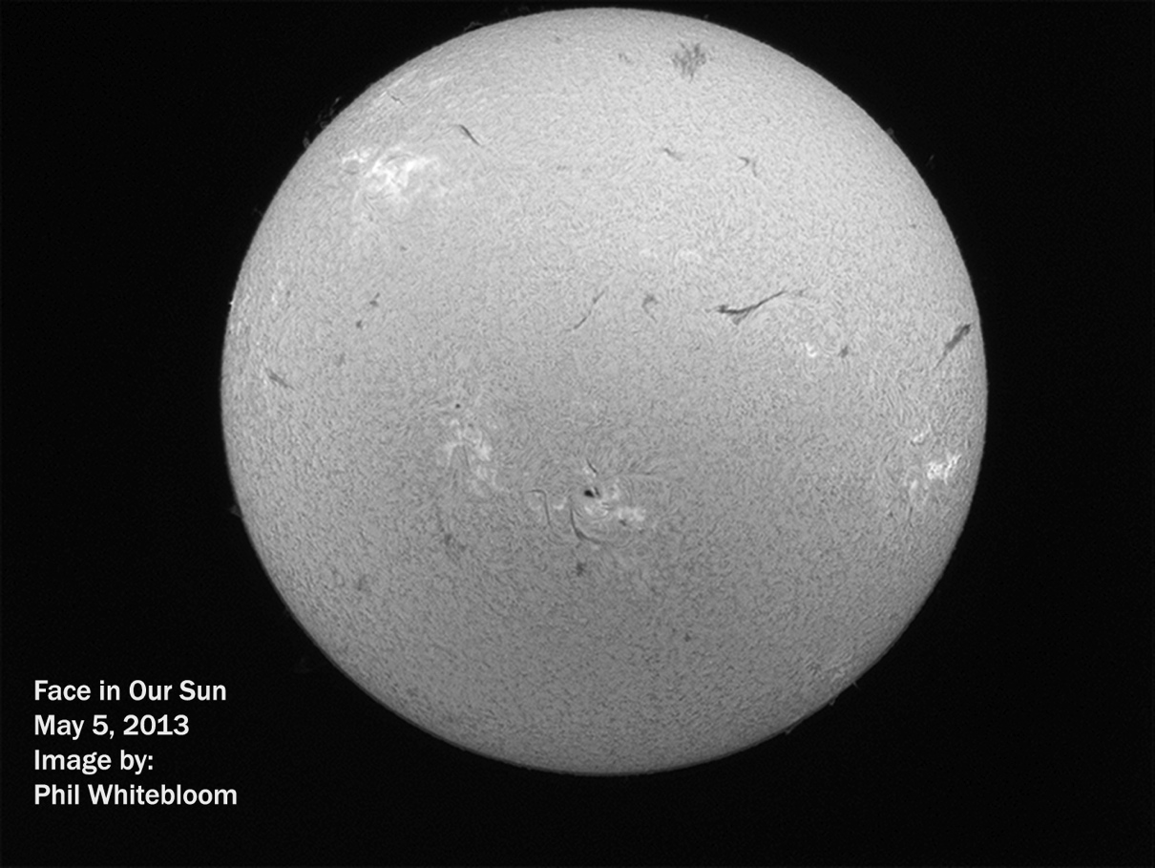

Slide 23
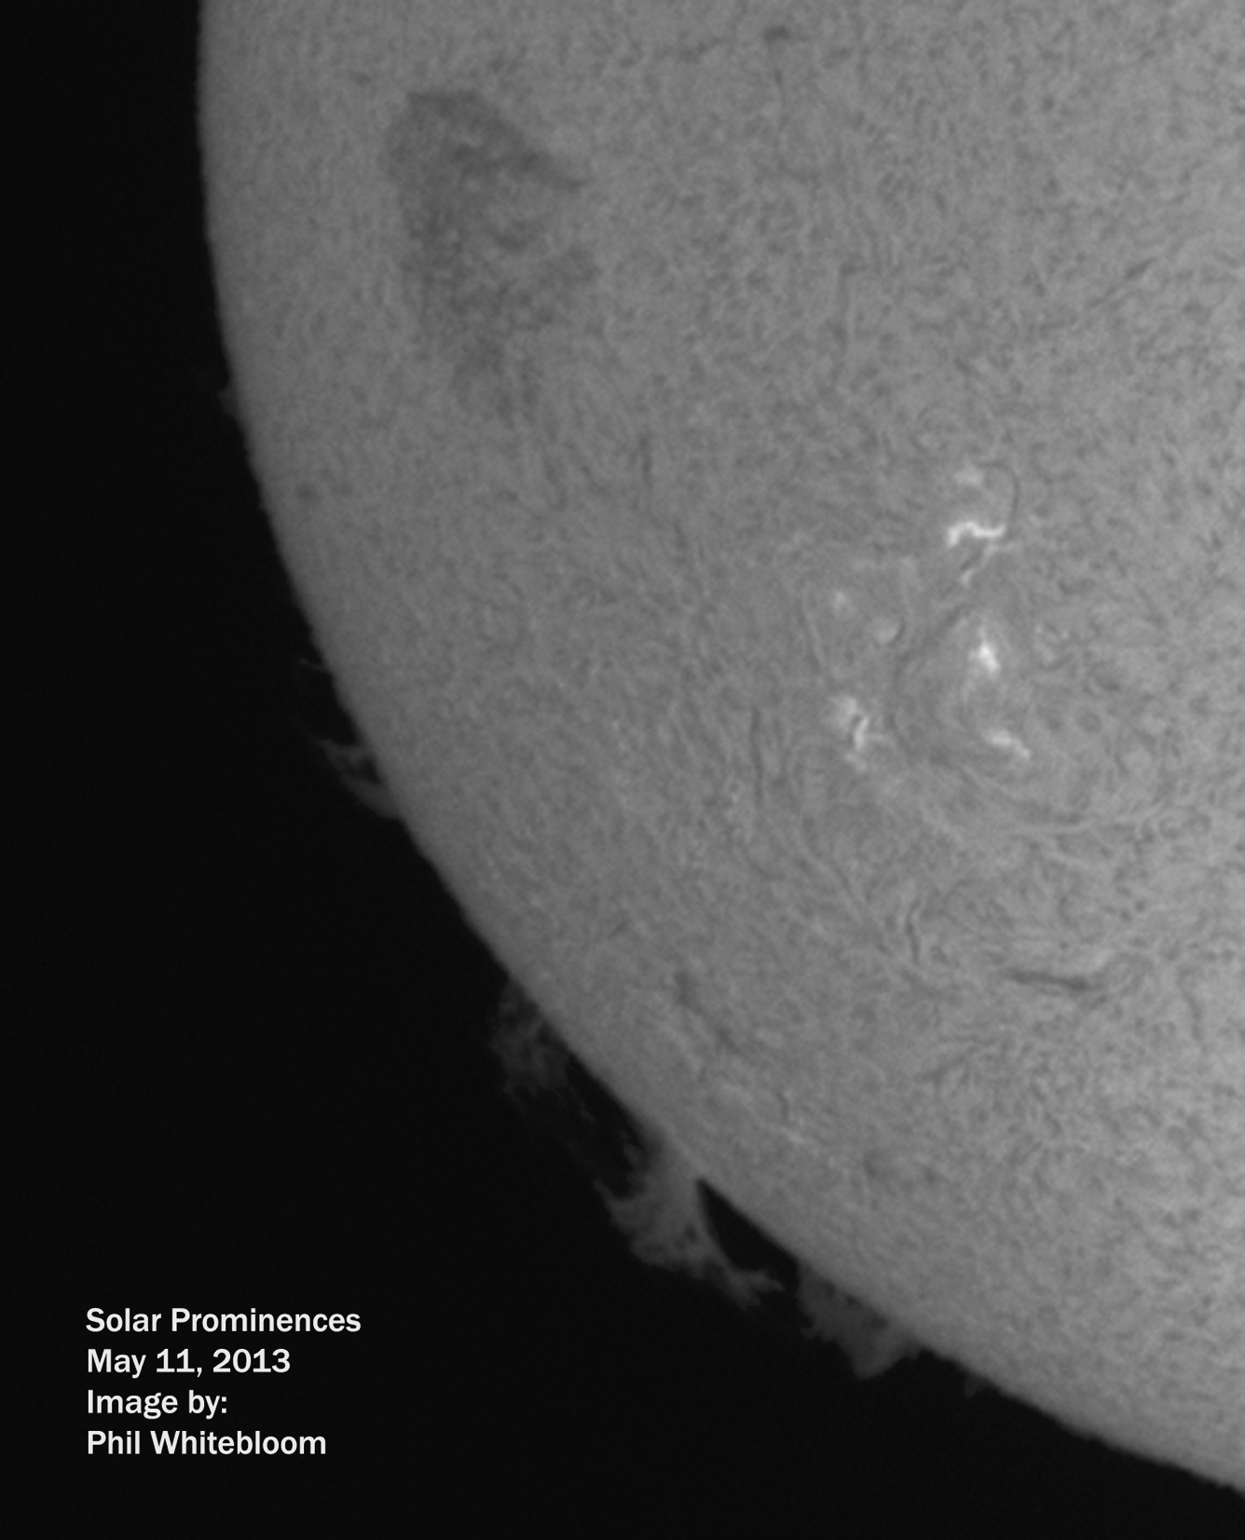

Slide 24
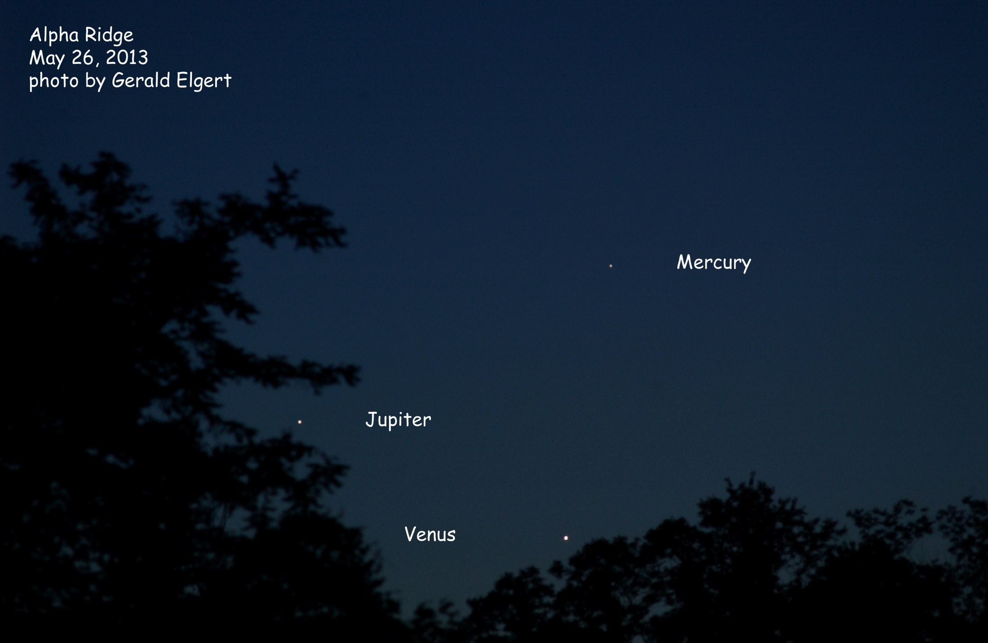

Slide 25
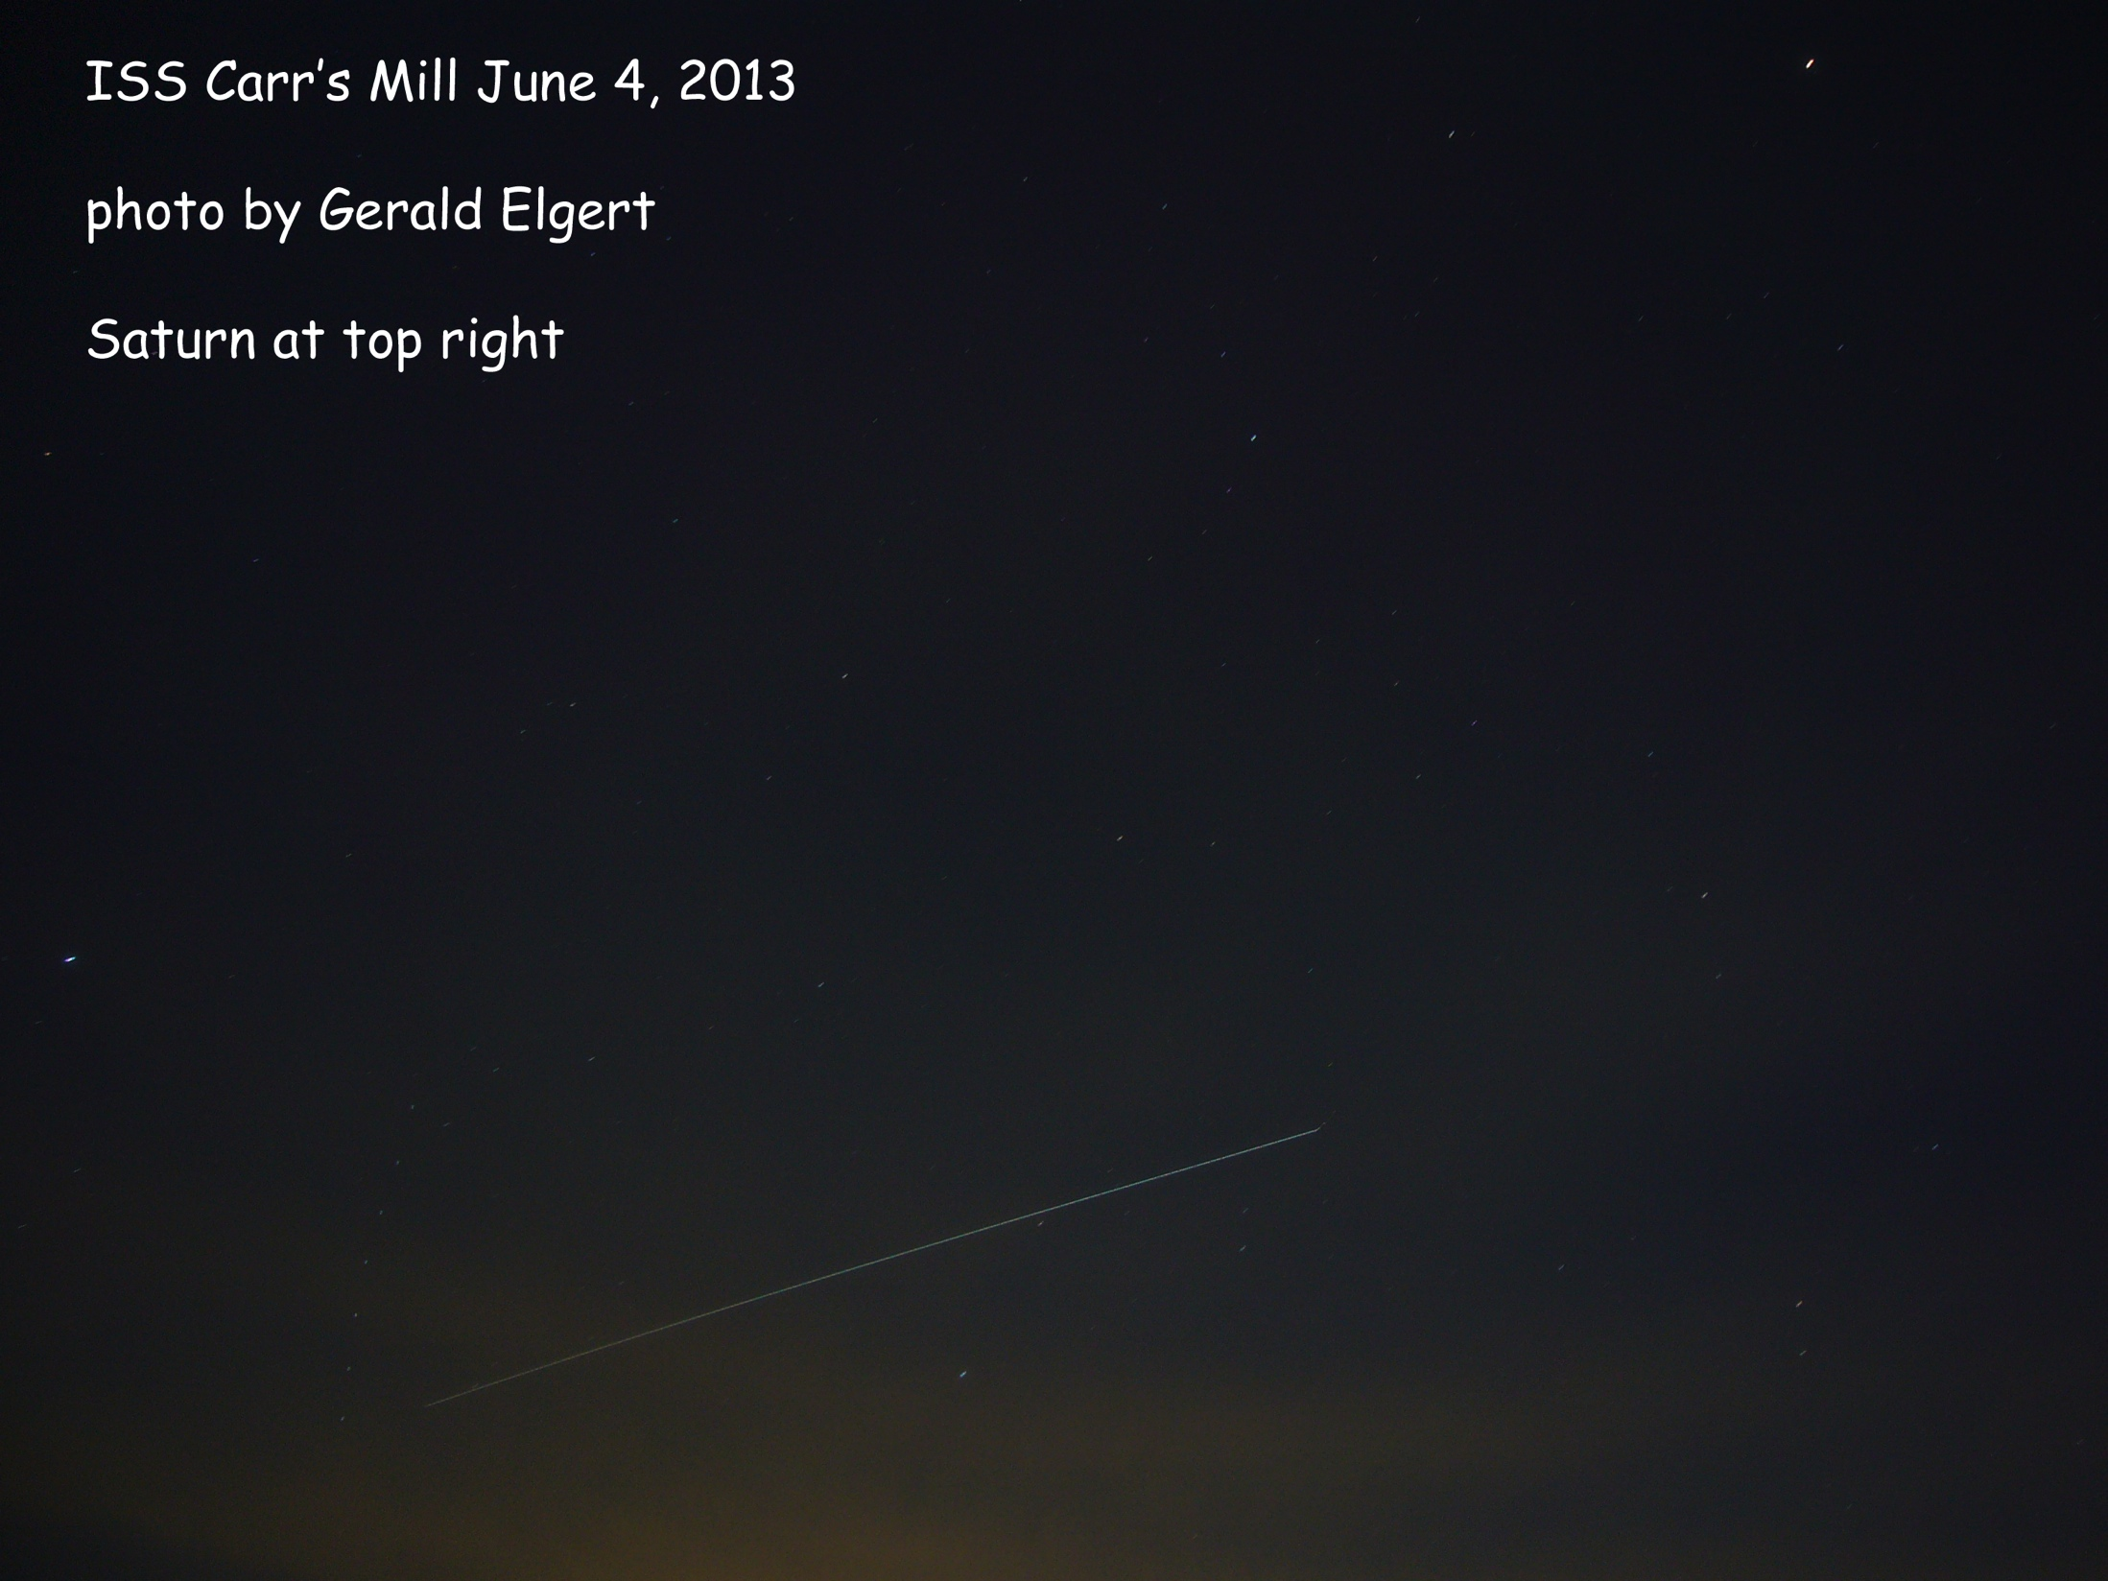
Name

Slide 26
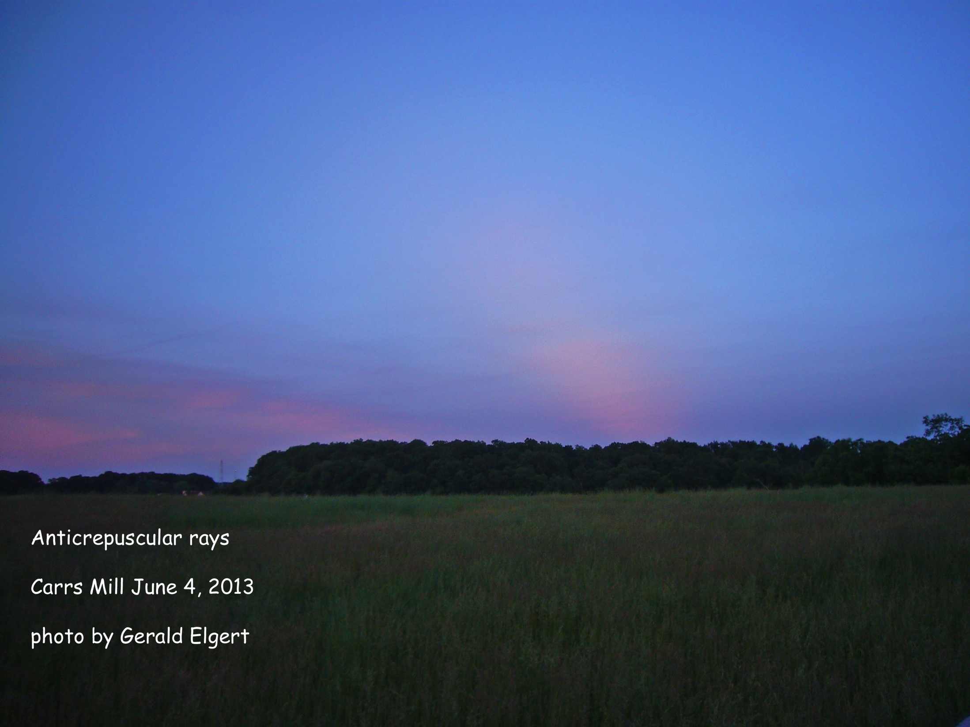
Name

Slide 27
So you wanna attend a regional star party?

Slide 28
What’s a regional Star Party?
Lasts 2-7 nights
Camp near your scope
Typically at dark sites in the middle of nowhere
Dozens to hundreds of attendees
Lots of scopes (many huge dobs and sweet refractors)
Fun!

Slide 29
Star Party Etiquette
Notes:
Prepare your car: remove/disable white lights
Arrive well before dark (most won’t let you enter after sunset)
Prepare your laptop – use red screen and turn brightness down, use a box or something to shield it from nearby observers
Beware overly bright red lights

Slide 30
Star Party Etiquette
WHITE LIGHT IS EVIL!!!!!!!
Notes:
Prepare your car: remove/disable white lights
Arrive well before dark (most won’t let you enter after sunset)
Prepare your laptop – use red screen and turn brightness down, use a box or something to shield it from nearby observers
Beware overly bright red lights

Slide 31
What to bring?
All your astronomy gear (make a list!)
Extra batteries (9V, AA, AAA, etc.) and other expendable supplies (chemical hand warmers, etc.)
Battery chargers
Camping gear (make a list!)
Cold/wet weather gear (even in summer!)
Food/snacks/water/coffee (sometimes)
Medicine and first aid

Slide 32
Where to go?
Delmarva Stargaze/No Frills
Mason Dixon
Cherry Springs
Almost Heaven
Greenbank StarQuest
Winter Star Party
Texas Star Party

Slide 33
Demlarva Stargaze and No Frills
Stargaze: Spring, No Frills: Fall
Three nights: Thursday, Friday, Saturday
Held at Tuckahoe State Park Equestrian Center – 60-90 minute drive
Very laid back and friendly (< 100 attendees)
Relatively cheap (~$40)
Relatively dark
Dew and skeeters can be a problem
Free coffee, but bring your own food (Fish Fry Saturday night), or hit local fast food in Denton
No vendors or speakers, no bathrooms or showers (porta johns), but there is a small raffle
No WiFi, but decent cell service

Slide 34
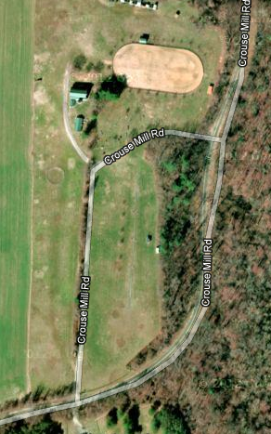
Demlarva Stargaze and No Frills

Slide 35
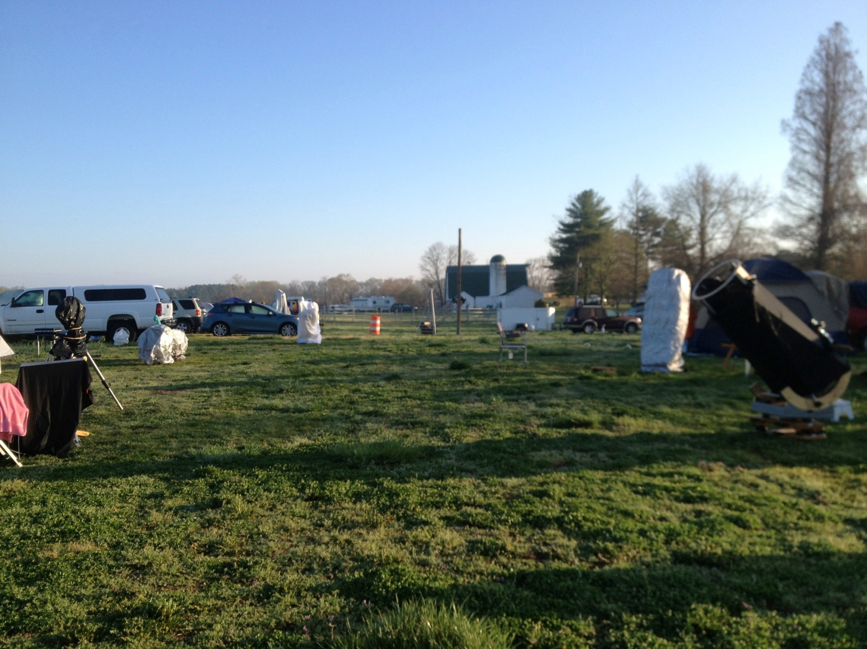
Demlarva Stargaze and No Frills
Chris Todd

Slide 36
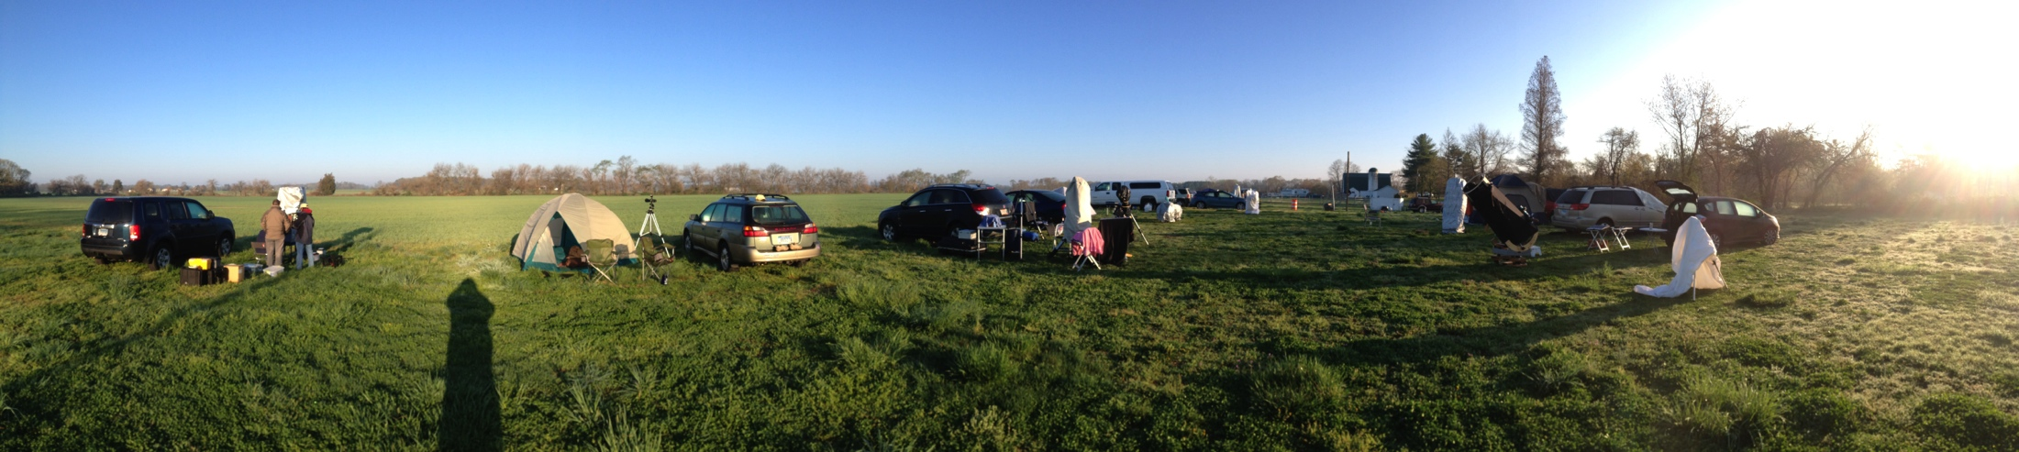
Delmarva Stargaze and No Frills
Chris Todd

Slide 37
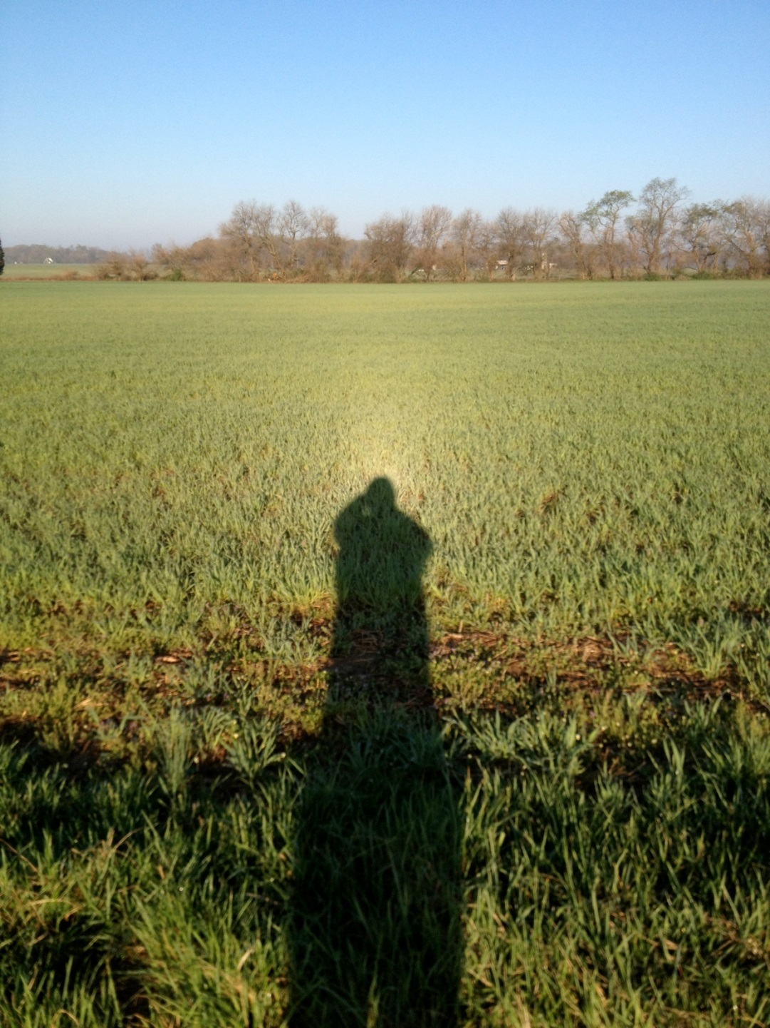
Delmarva Stargaze and No Frills
Chris Todd

Slide 38
Mason Dixon
Summer
Four nights: Wednesday through Saturday
Held on an airfield near York, PA (nice flat ground) – about 90 minute drive
Laid back (< 100 attendees)
Relatively cheap (~$35)
Relatively dark – maybe same as Tuckahoe
Food vendor, but consider bringing food
Speakers and vendors (raffle?)
Real bathrooms, but no showers
No WiFi, but decent cell service

Slide 39
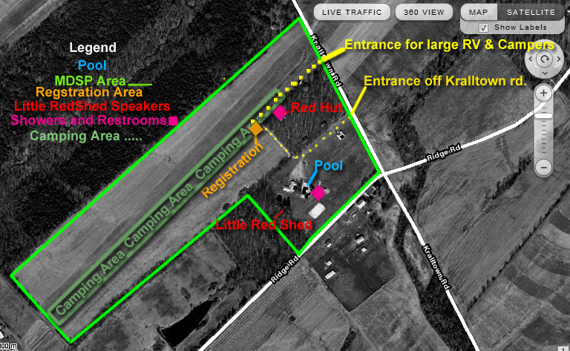
Mason Dixon
Map and pictures

Slide 40
Cherry Springs
CSSP: June, Black Forest: September
CSSP: Three nights: Thursday, Friday, Saturday
BFSP: Two nights: Friday, Saturday
Held at Cherry Springs State Park (IDA Dark Park), about 5-6 hour drive
Dedicated astronomy park – VERY, VERY DARK!
Hundreds of attendees – lots of big scopes. Often sells out.
AC Electrical all over the field
Relatively cheap (~$40)
Dew and skeeters can be a problem
Food vendor quite good and up all night
Quite a few vendors, good raffle, and good speakers
Real bathrooms, showers available at nearby park
Very spotty cell service, but they have WiFi, though it can be flaky

Slide 41
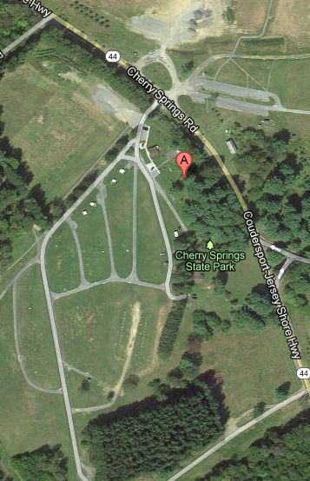
Cherry Springs

Slide 42
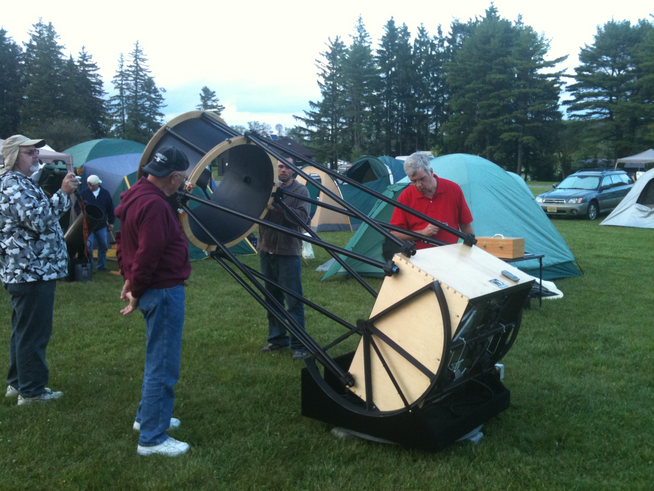
Cherry Springs
Chris Todd

Slide 43
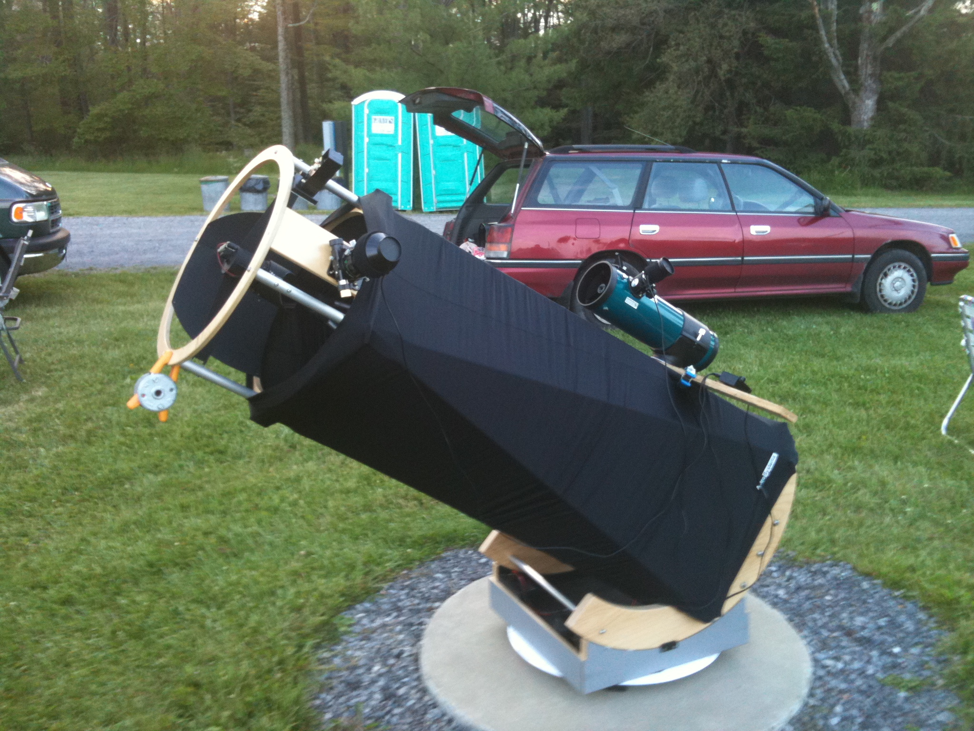
Cherry Springs
Chris Todd

Slide 44
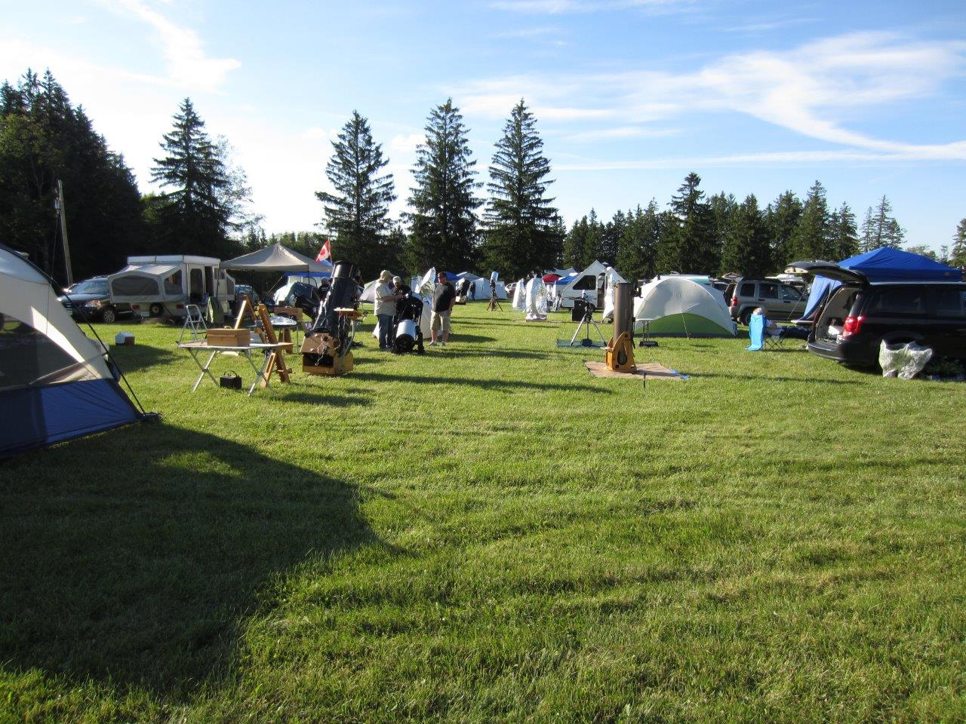
Cherry Springs
Dave Tillman

Slide 45
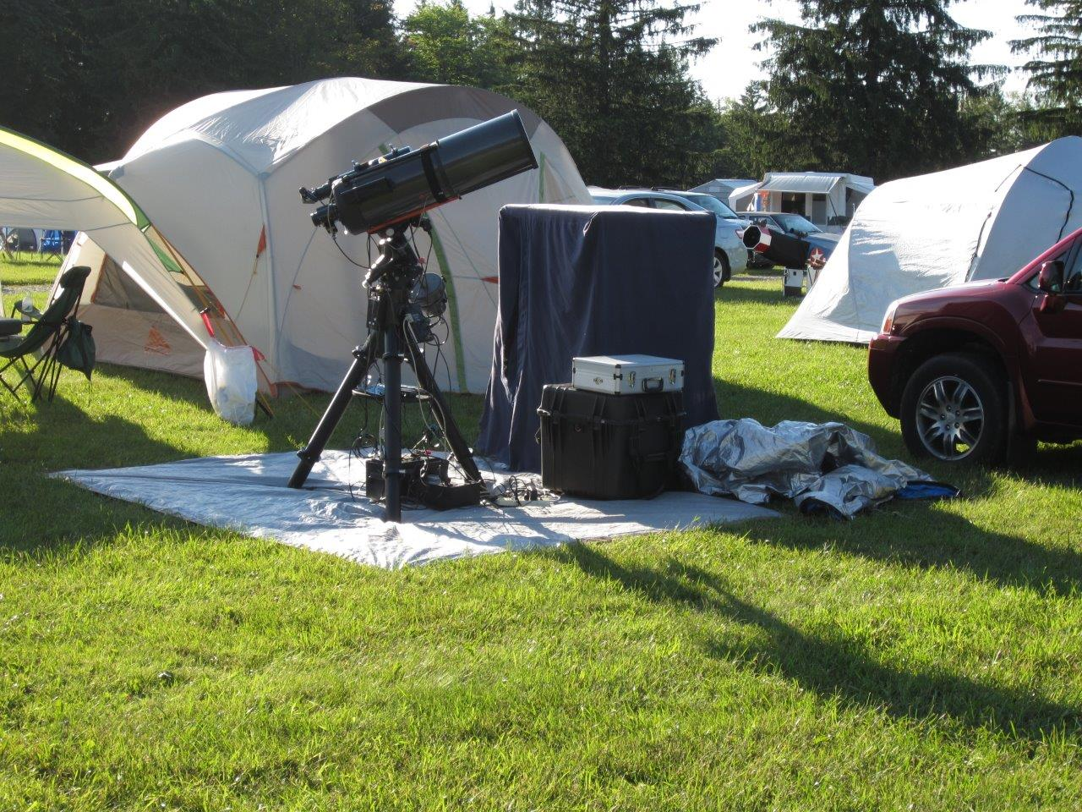
Cherry Springs
Dave Tillman

Slide 46
Almost Heaven Star Party
Held at The Mountain Institute on Spruce Knob, WV, about 5-6 hour drive, in late August or September
Four nights: Friday through Tuesday
Middle of nowhere, at > 4,000 ft – VERY, VERY DARK!
Hundreds of attendees – ALWAYS SELLS OUT
No AC on field, but can recharge batteries at Yurt
Moderately expensive (~$100+)
Weather variable and can be extreme (and cold!)
Meal plan excellent, but not cheap
Several vendors, great raffle, and excellent speakers
Real bathrooms and showers!
No wireless service (National Radio Quiet Zone), but WiFi available
Field can be uneven; scope setup can be challenging

Slide 47
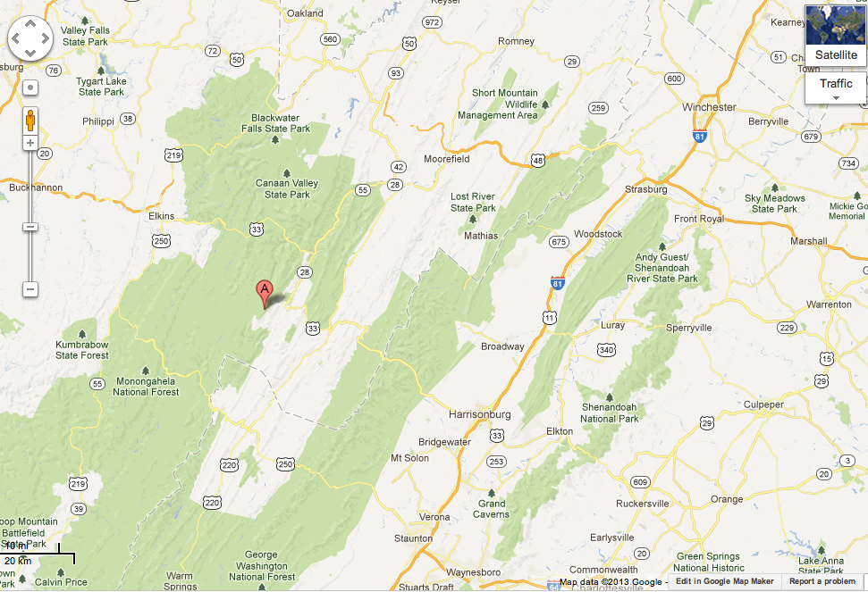

Slide 48
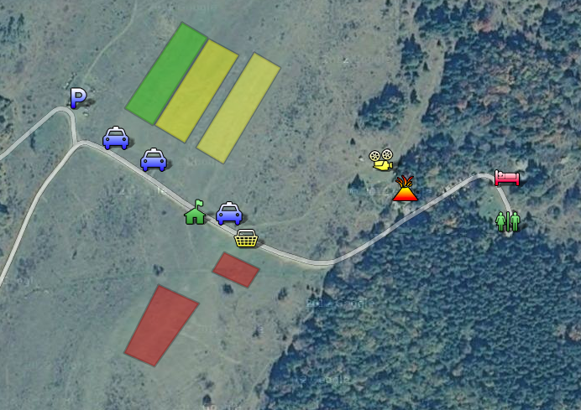

Slide 49
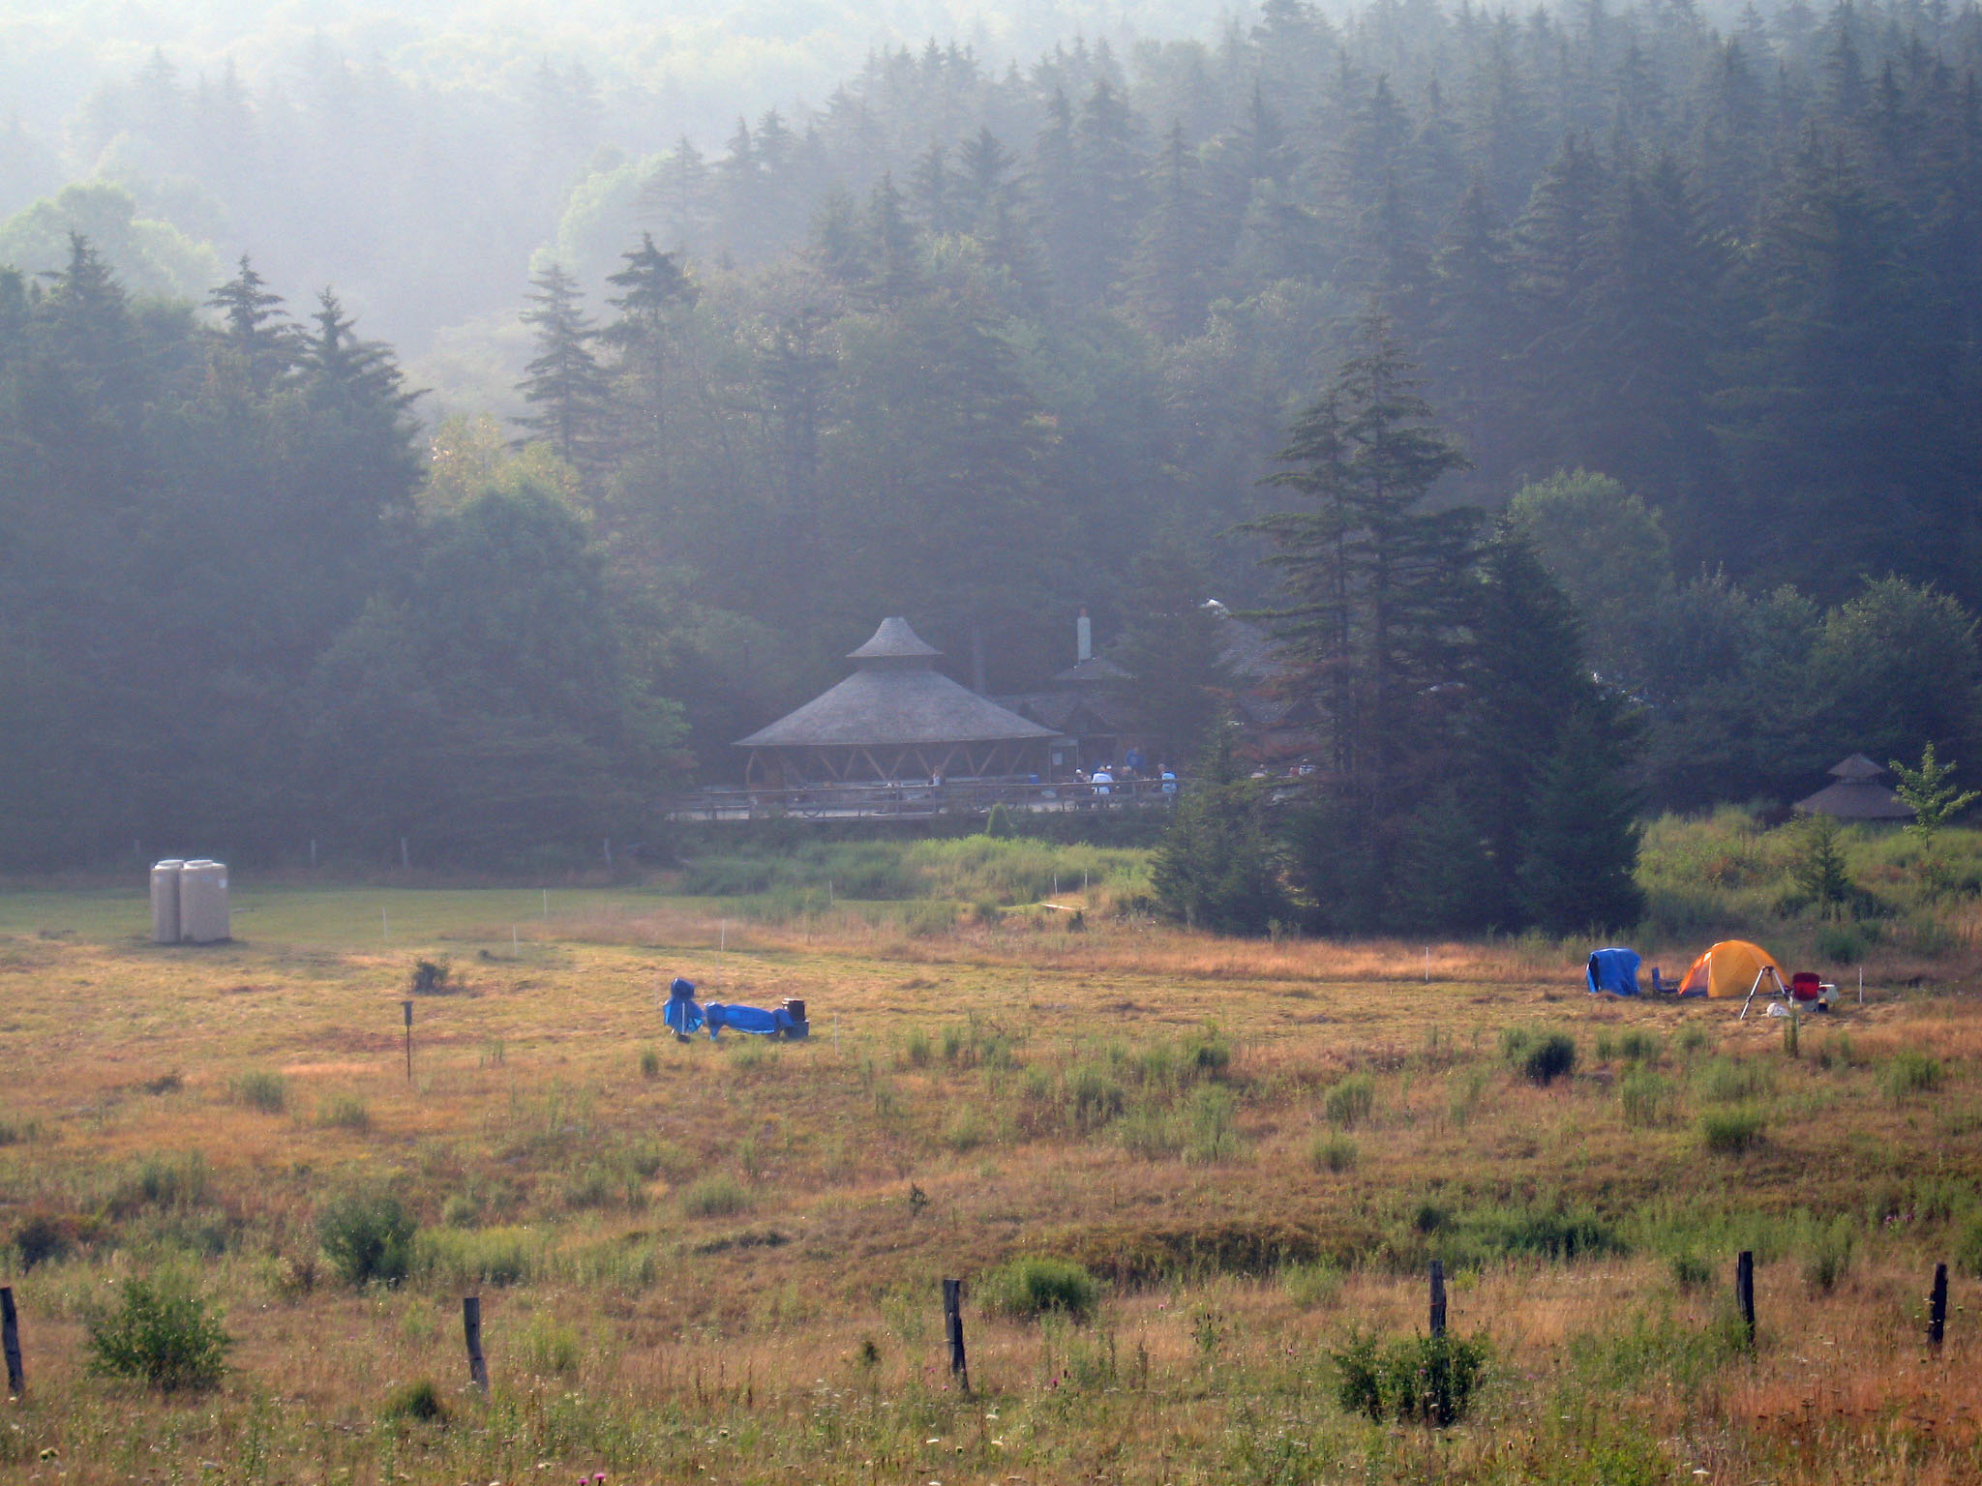

Slide 50
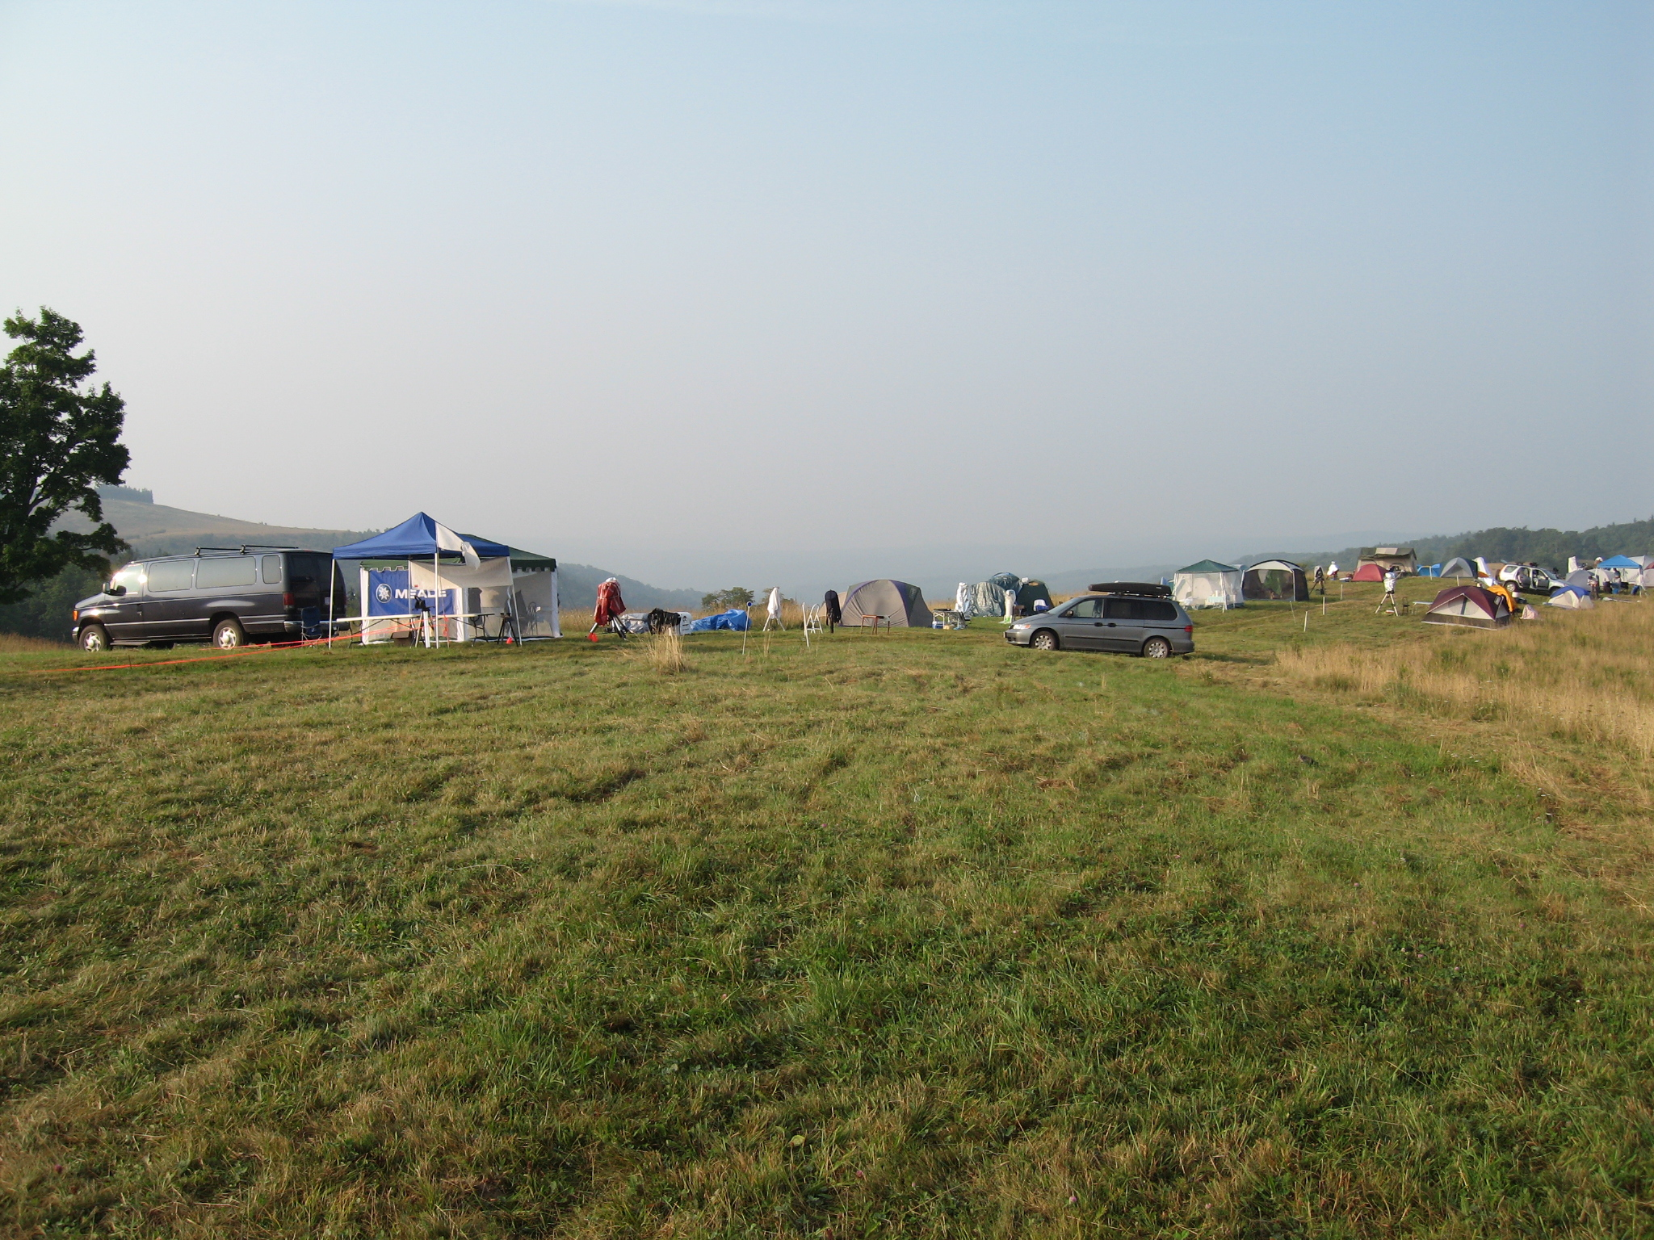

Slide 51
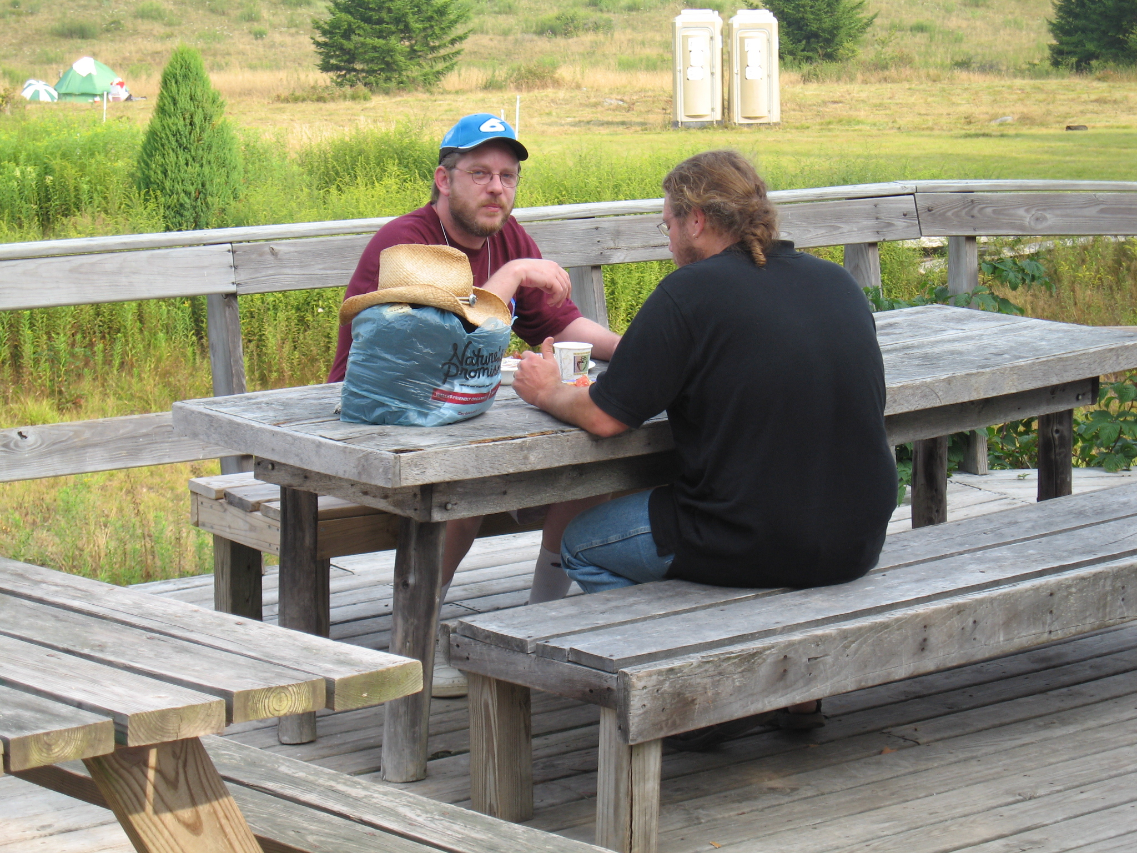

Slide 52
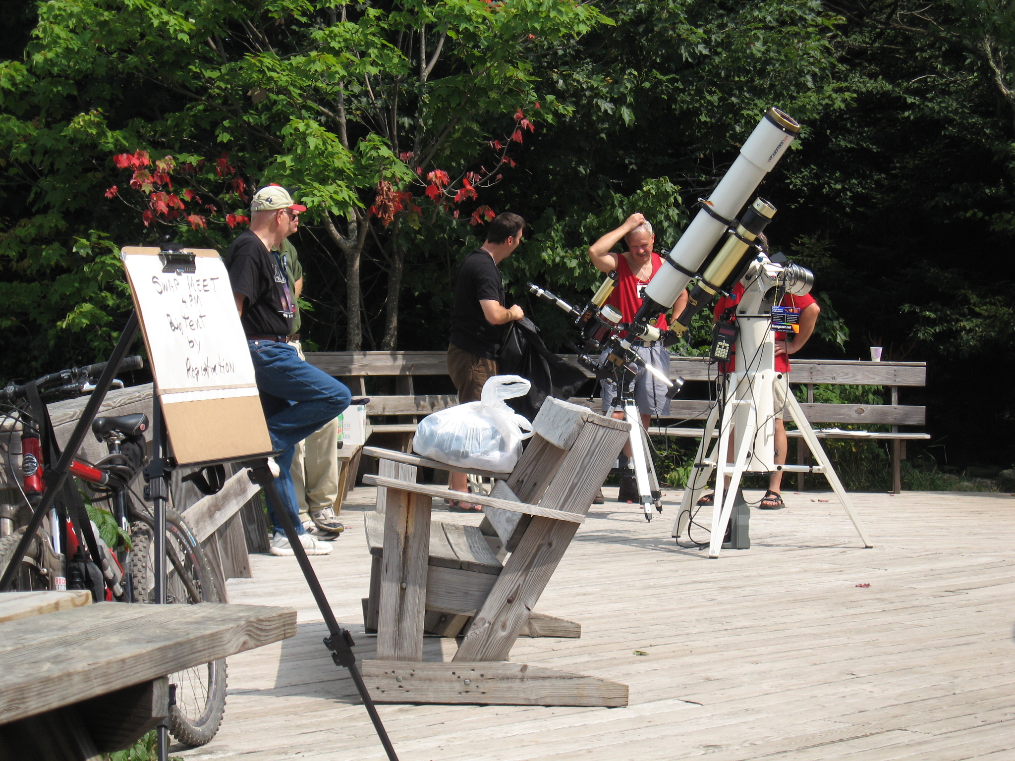

Slide 53
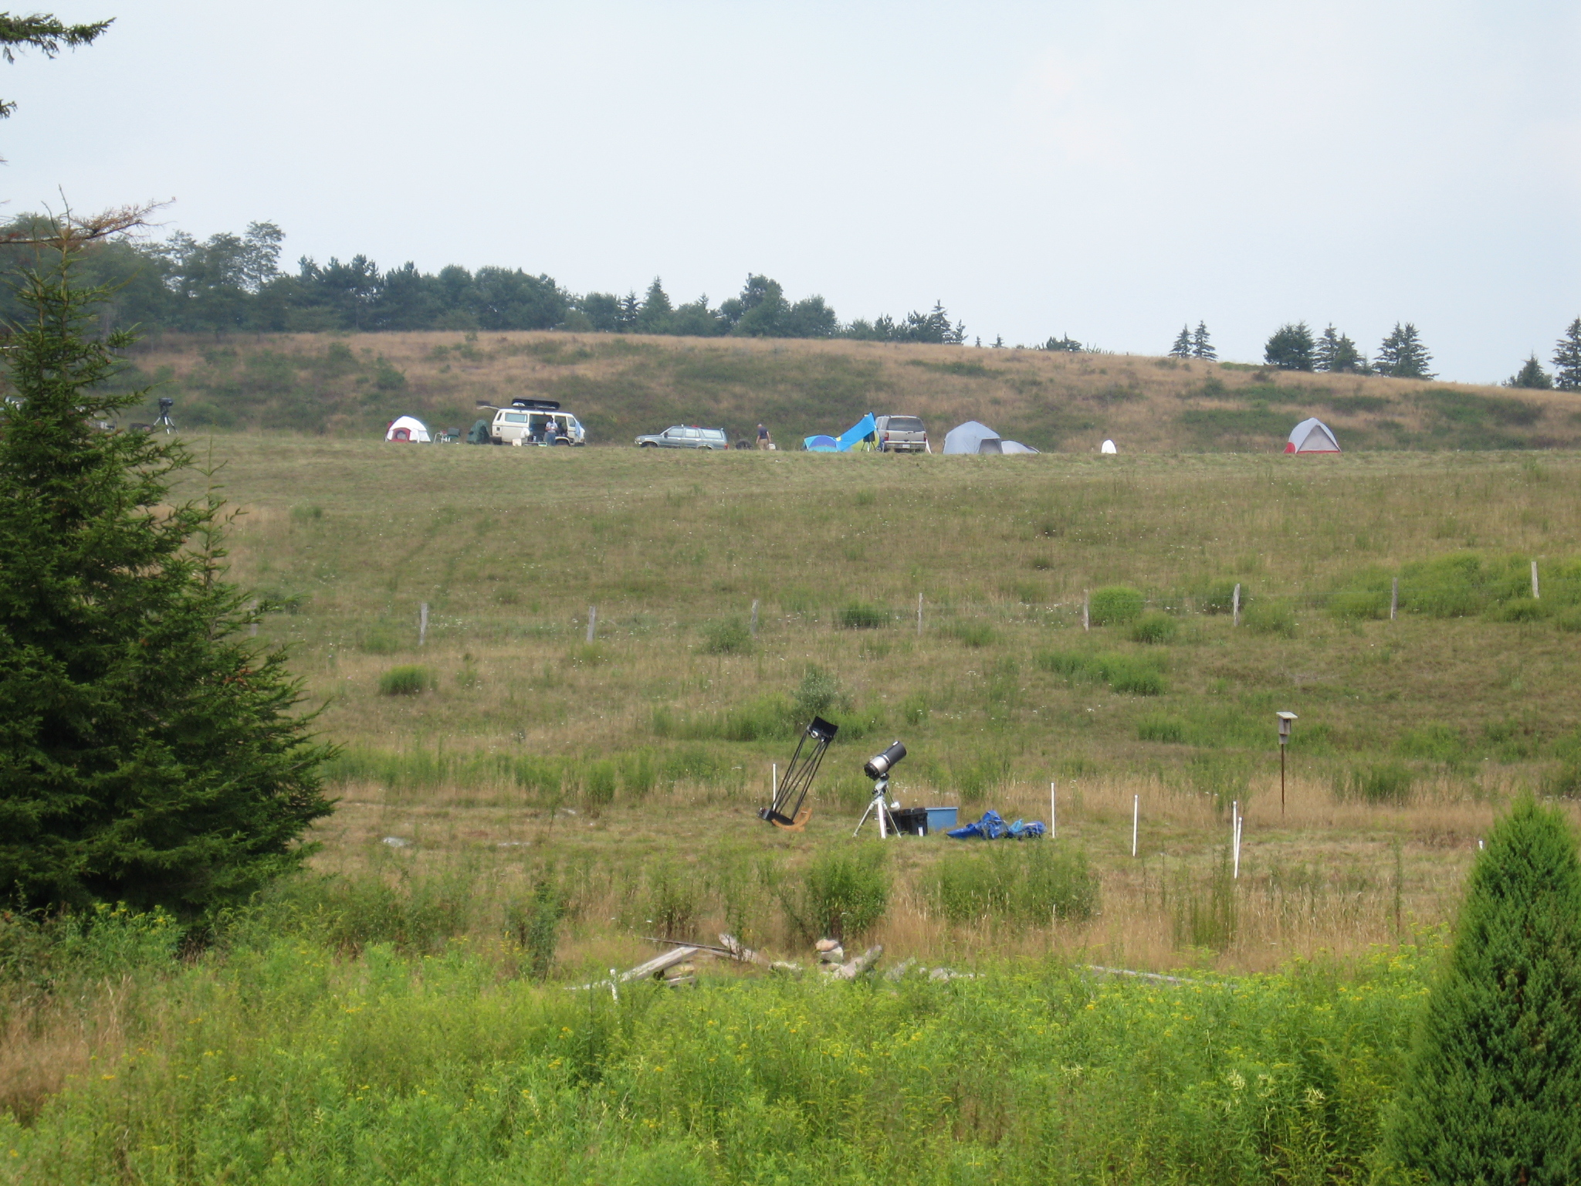
Almost Heaven Star Party

Slide 54
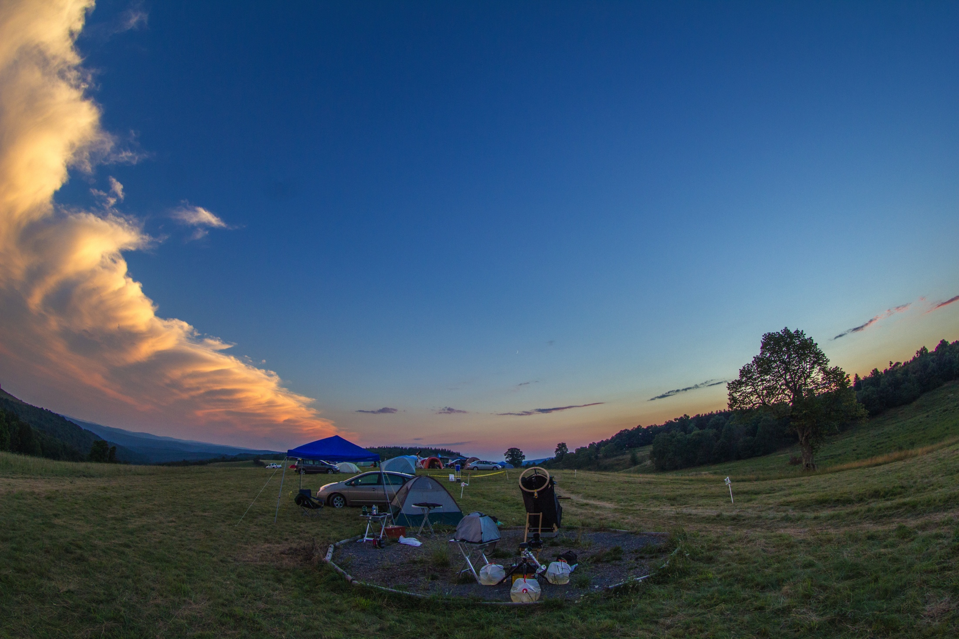
Almost Heaven Star Party

Slide 55
Notes:
Break out here for your time-lapse from Monday night at AHSP2012. Also show the star trails 30 fps.

Slide 56
Greenbank StarQuest
Four nights: Wednesday-Sunday
Held at National Radio Astronomy Observatory, Greenbank, WV, about 5-6 hour drive, usually in July
Extremely cool facility, and very family friendly
Almost as dark as AHSP, but you’re in a valley – dew and fog is bad
100-200 attendees
Flat field, no AC on field, but can recharge batteries at barn
Moderately expensive (~$85)
Meal plan quite good in cafeteria, Starlight Café has great milkshakes
Quite a few vendors, good raffle, and lots of excellent speakers
No wireless service (National Radio Quiet Zone), but Internet available in computer lab
Electronics on the field can cause problems for Radio Telescopes – you might be asked to turn some things off. Leave your cell phone off.
Real bathrooms and showers – bunkhouse available at slight extra cost

Slide 57
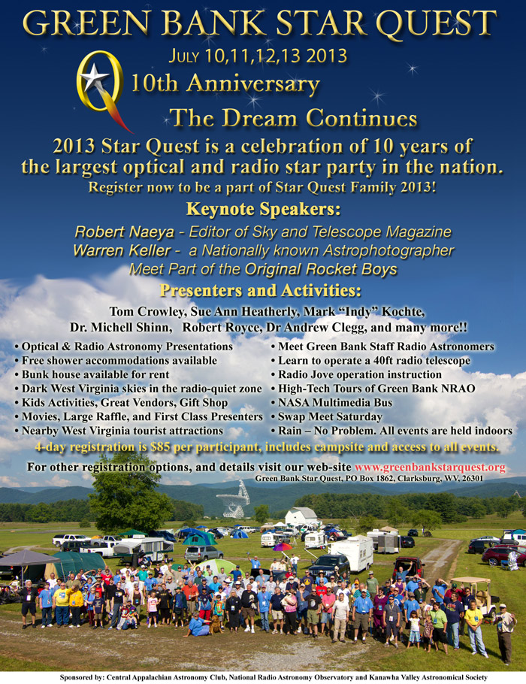

Slide 58
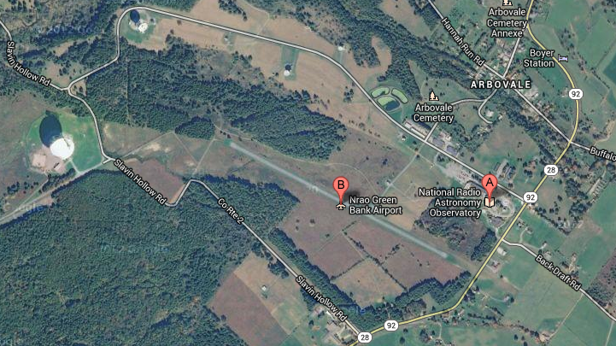
Greenbank StarQuest

Slide 59
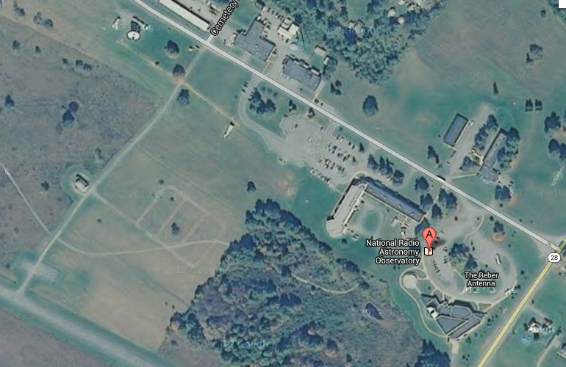
Greenbank StarQuest

Slide 60
Notes:
Insert time lapse video of night sky at Greenbank

Slide 61
Winter Star Party
February 24-March 2, 2014 – SIX NIGHTS!
Held at Camp Wesumkee, Scout Key, FL
Very dark to the South, light domes to Northwest and Northeast
25* latitude – Orion is at ~ 60*, Omega Centauri gets to 18*, and Eta Carina nebula gets to about 7*
Best seeing conditions you have ever seen!
Daytime highs in the 70s to 80, night time lows in 60s to 70s
Hundreds of attendees – lots of big scopes. Used to sell out every year, hasn’t in several years
AC Electrical all over the field (bring your own 100’ extension cord)
Expensive to register, and to get there (~$180 registration and camping)
Dew and wind can be a problem
Food vendor quite good, but you’re only 20-30 minutes from civilization and excellent restaurants
Many vendors, excellent raffle, and excellent speakers
Real bathrooms and showers
No WiFi, but good cell service

Slide 62
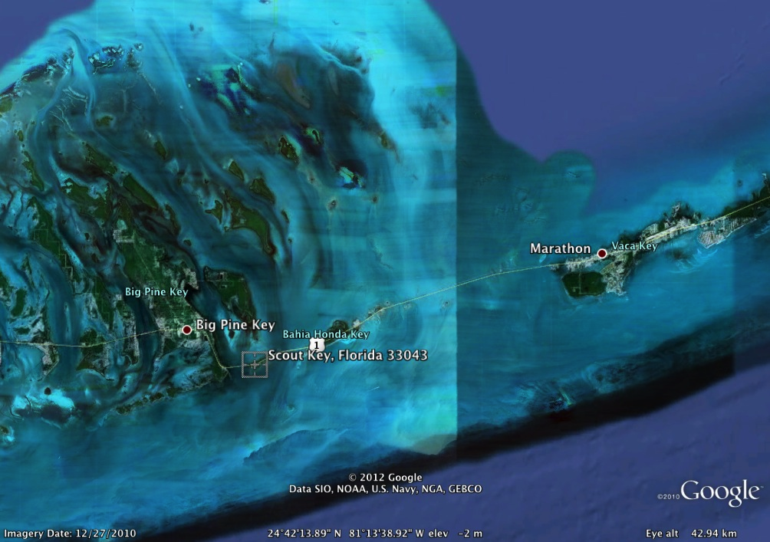
Winter Star Party

Slide 63
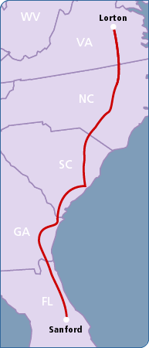
Winter Star Party
Auto Train is easiest
Depart Lorton, VA @ 4 pm
Arrive Sanford, FL @ 8 am
Get a sleeping birth
Not cheap, but better than driving 18 hours

Slide 64
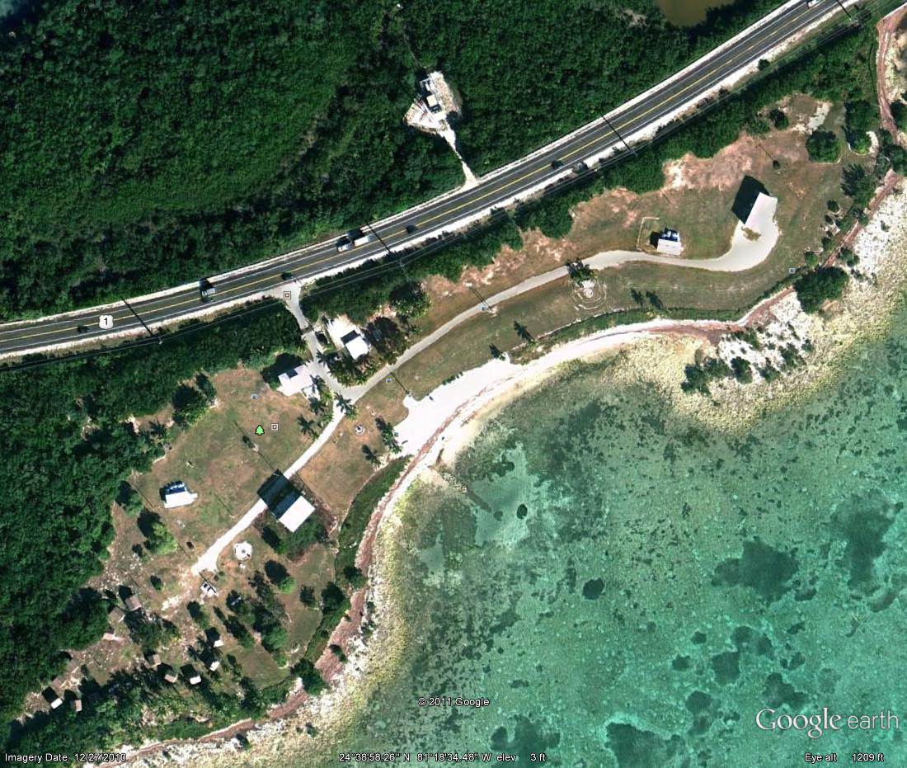
Winter Star Party

Slide 65
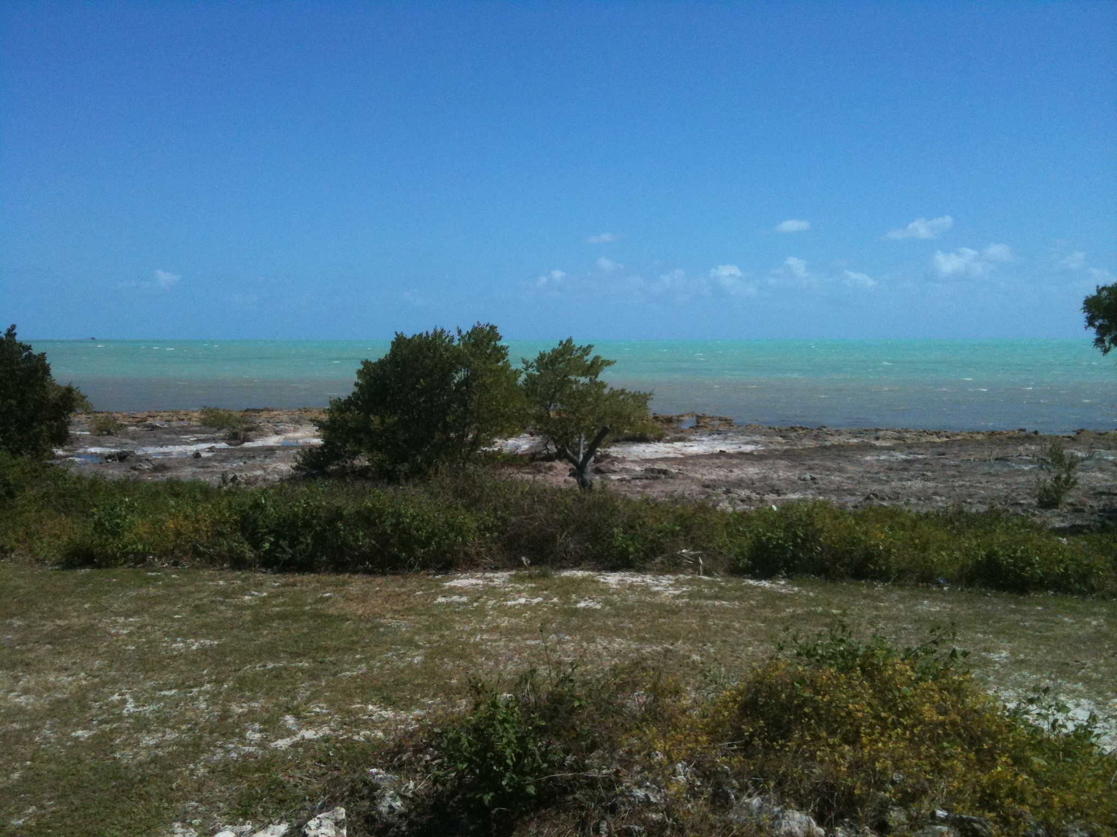
Winter Star Party

Slide 66
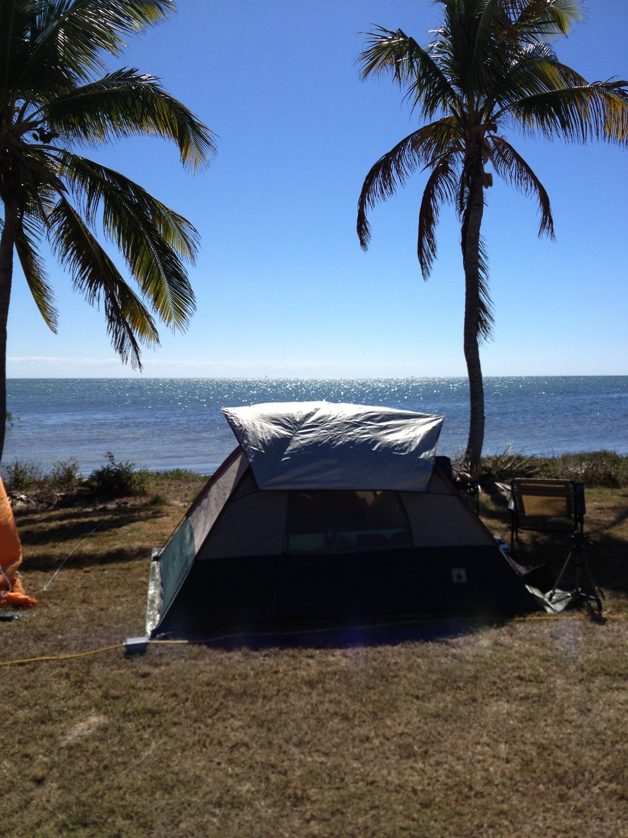
Winter Star Party

Slide 67
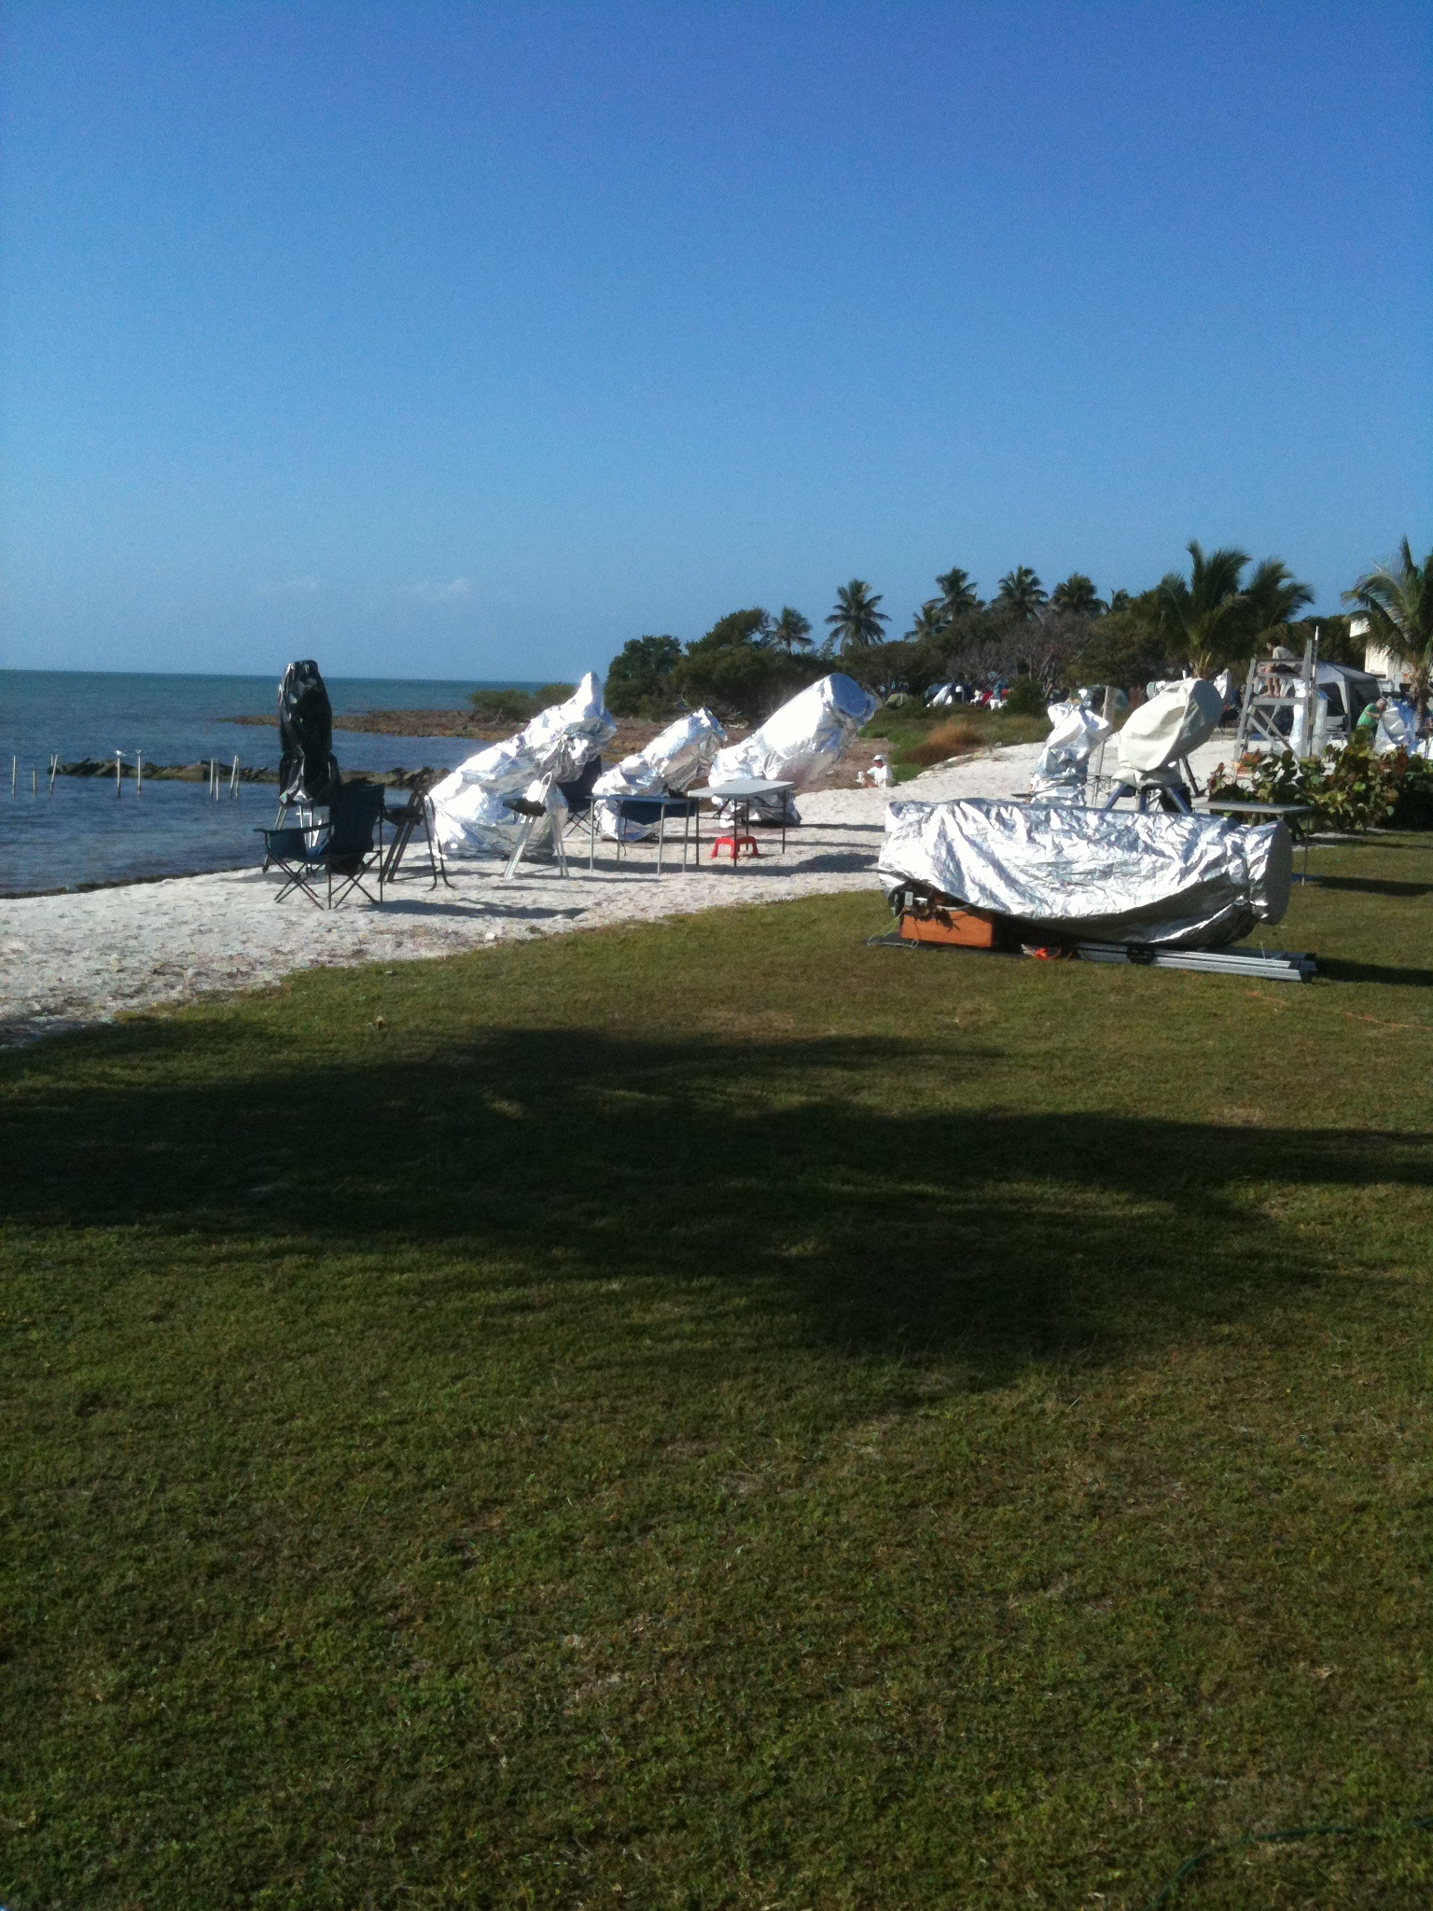
Winter Star Party

Slide 68
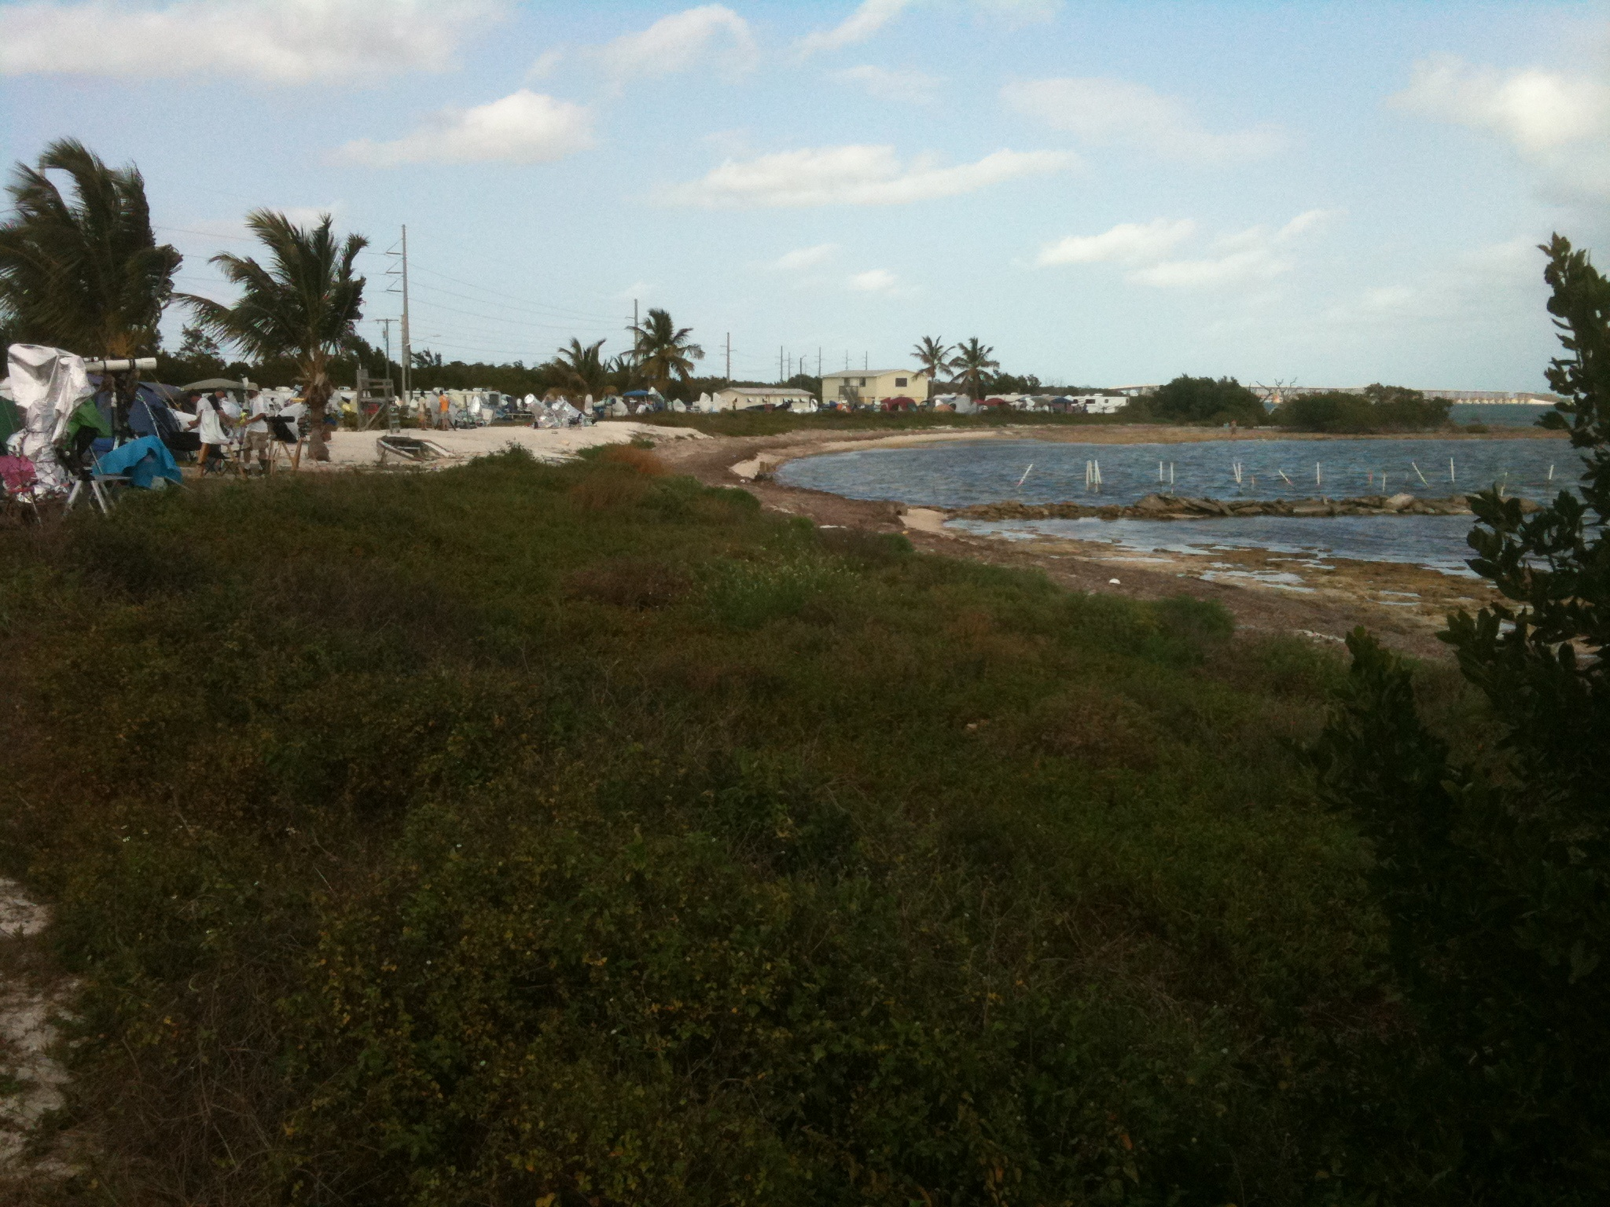
Winter Star Party

Slide 69
Winter Star Party
Night sky time-lapse
Notes:
Break out for the night sky time-lapse you shot this year and last year.

Slide 70
Texas Star Party
Seven nights, typically in Spring (April or May; May 5-12, 2013)
Held at Prude Guest Ranch, Fort Davis, Texas, at > 5,000 feet, in the middle of nowhere. Prude Guest Ranch is awesome facility
Probably the darkest skies you’ll ever see
Hundreds of attendees – lots of big scopes (including 36” dob)
AC Electrical all over the field
Surprisingly reasonable registration (~$60)
Don’t bother camping, get a spot in the bunkhouse ($45/day, includes meals!) Food is awesome and plentiful
Dew is almost never a problem, but bring ChapStick and a tarp (dust!)
Quite a few vendors, good raffle, and good speakers
Real bathrooms and showers, bunkhouses have heat and A/C
McDonald Observatory is awesome and worth a tour, and Fort Davis is a charming little town, with a few decent restaurants, Fort Davis is a neat piece of history, and Davis Mountains State Park is nearby
Weak and spotty cell service, but WiFi available on the observing field

Slide 71
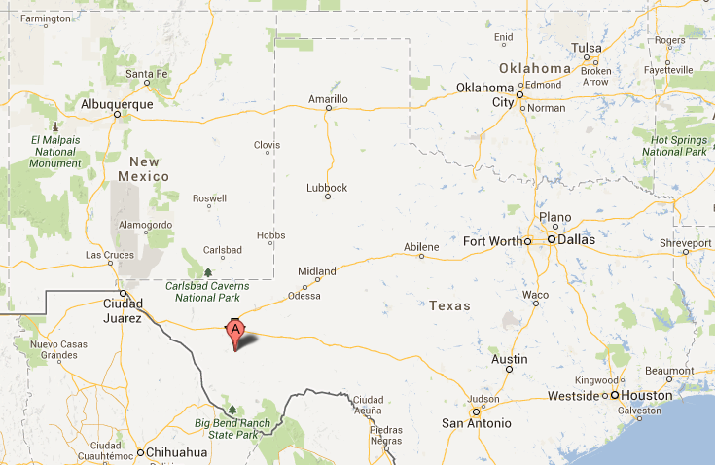
Texas Star Party
Map and pictures

Slide 72
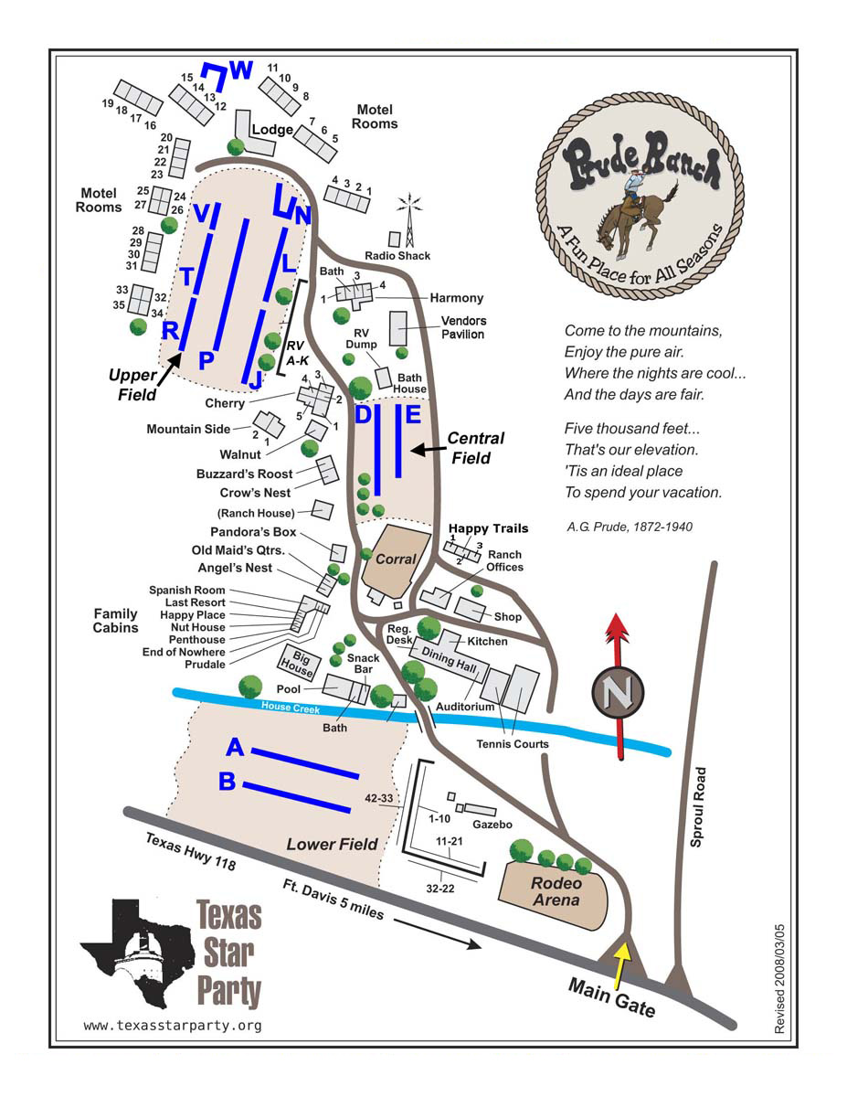

Slide 73
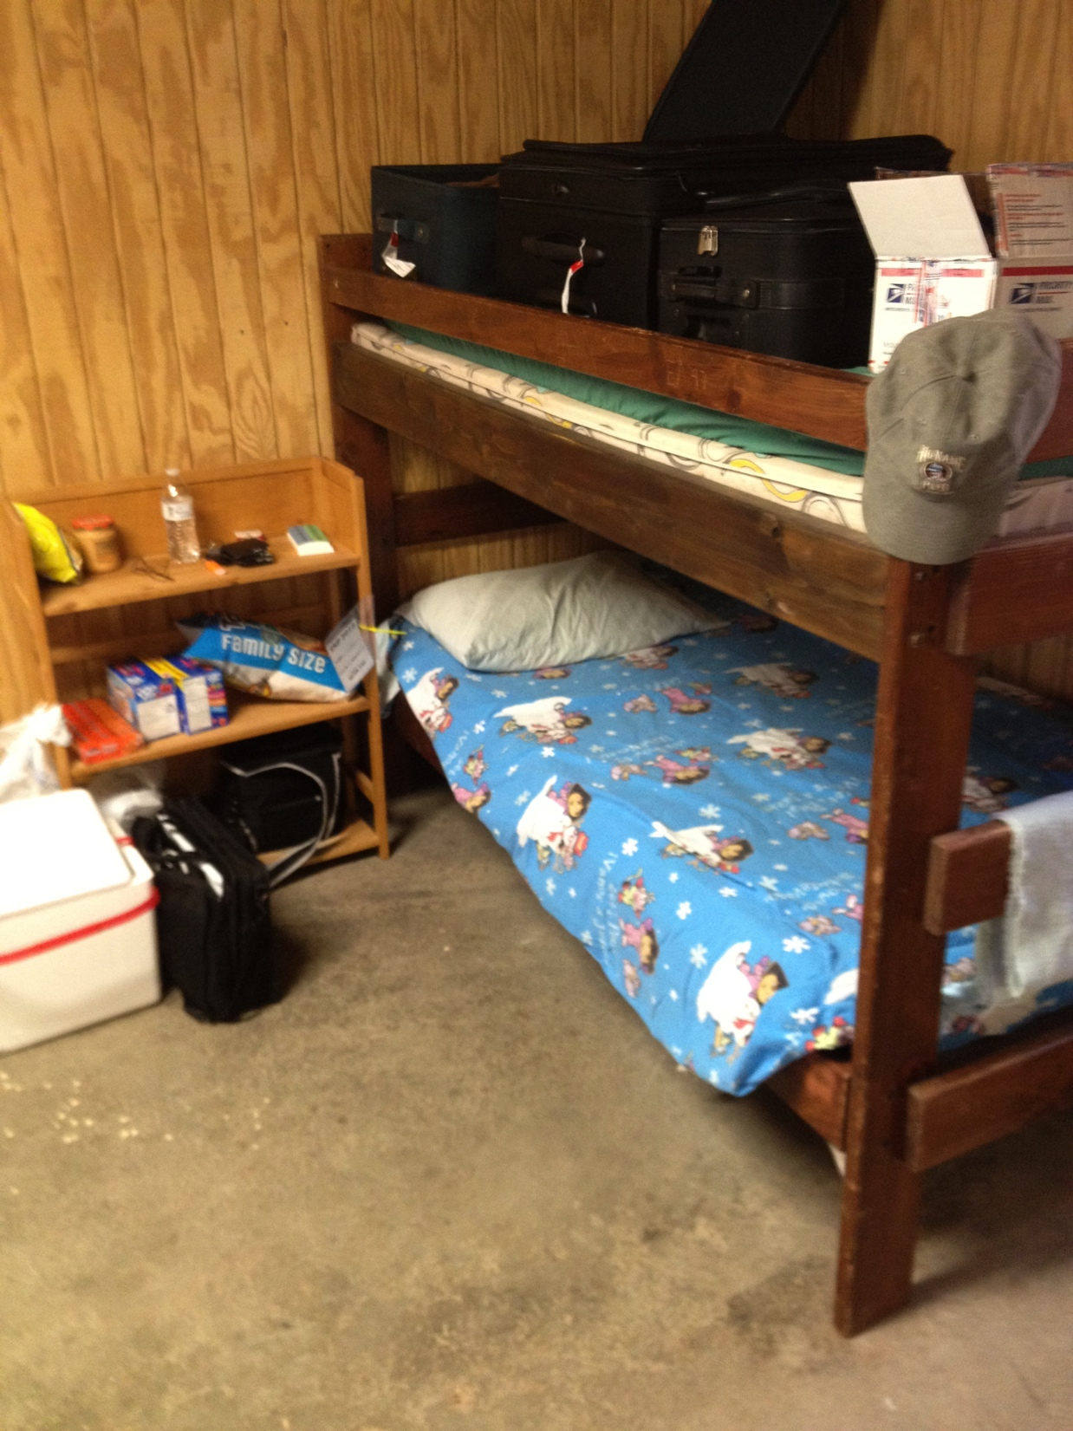
Texas Star Party

Slide 74

Texas Star Party

Slide 75

Texas Star Party
Field and scope pictures

Slide 76

Texas Star Party
Field and scope pictures

Slide 77

Texas Star Party
Field and scope pictures

Slide 78

Texas Star Party
Field and scope pictures

Slide 79

Field and scope pictures

Slide 80


Slide 81


Slide 82
Texas Star Party
Night sky time-lapse
Notes:
Break out for your time lapses from last year

Slide 83
Stumper answer

Slide 84
At what percentage illumination does Venus reach its greatest brightness (in 2013)?
28%, when it reaches an apparent magnitude of -4.5

Slide 85
Thank You!
Next month’s meeting is on Thursday,
July 18, 2013
7:30 PM
Guest speakers:
I have no idea yet

